Slide 1
Utilising Conversation Partners in Self-Access Learning Centers
Richard Hill and Robert Primeau

Slide 2
Outline
Conversation Partners
5 things I would have liked to know
Scenarios to look out for
Our experience
Our ideas

Slide 3
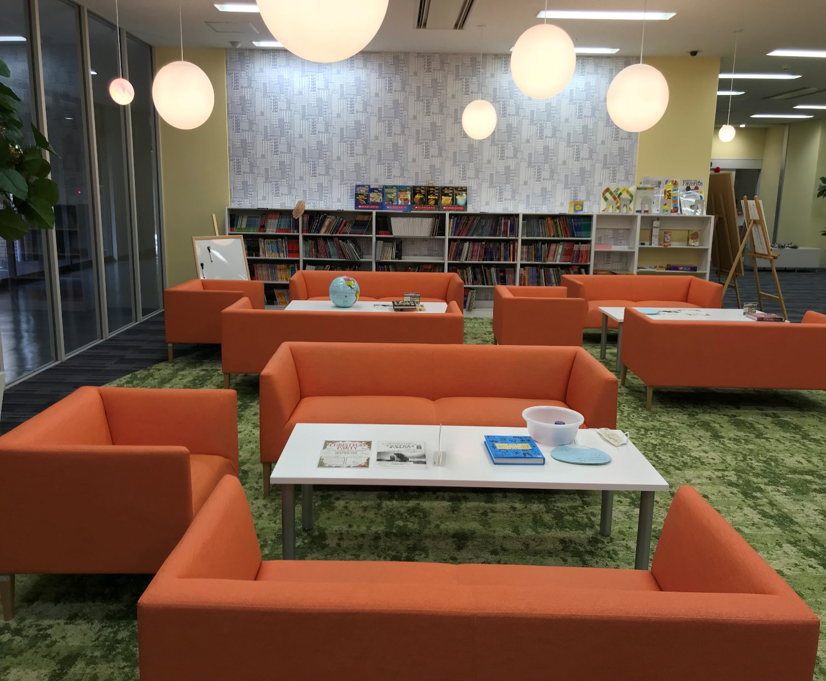
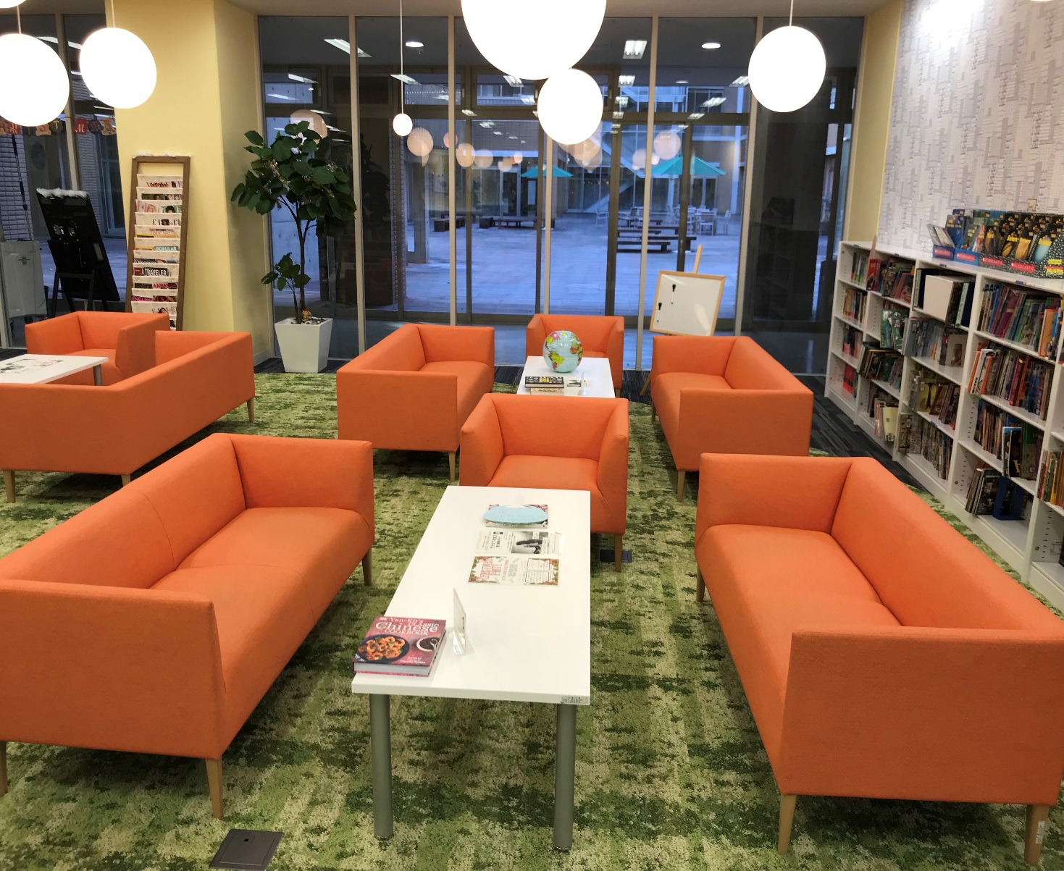
Meijo University: Social Area

Slide 4

What is a conversation partner?
Active facilitator of conversation

Slide 5

Why look at conversation partners?

Slide 6
Why look at conversation partners?
Unique to Self-Access Learning Centers
Can be influential to the atmosphere
Time with partners and management can be limited

Slide 7
5 things I wish I knew when I started
1. Let the learners choose
2. Build a conversation
3. Talk about what is happening
4. Keep a record
5. Bring a backup

Slide 8



1. Let the learners choose
The conversation partner doesn’t need to carry the whole conversation.
Some CPs like to turn the conversation into an interview.
Let the conversations be communicative.
Notes:
It’s autonomy with a social component. Learner Autonomy
Different students have different learning styles
It’s not one size fits all
Best indicatoes of learning are motivation and aptitude (Rod Elis)

Slide 9

Atlas complex and learner autonomy
Let the learner take responsibility and allow the conversation to go where they want it to go.
The best conversation for the students are the ones that they want to have.

Slide 10

2. Build a conversation
Build the conversation gradually.
Don’t ask everything in one meeting.
Give an incentive for learners to return.
Notes:
Push and pull

Slide 11

5 steps
Intros and greetings
Small talk
First topic
Second topic
Finish
Notes:
Teach how to start a conversation with a foreigner
Do Role plays

Slide 12

3. Talk about what is happening
Be aware of current events at the school or in the area.
Ask the students if they are participating in those events.
The information can be useful for a future conversation with new students or a follow up.

Slide 13

4. Keep a record
Keep a journal if possible to remember the student’s names.
Track who you have spoken to and what topics you covered.
This builds rapport and leads to meaning conversations that are multi sessions.

Slide 14
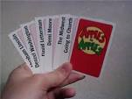

5. Bring a backup
Bring activities as a backup and to cater to different English abilities:
  Apples to apples
  Card games
  Pronunciation journey
  20 questions
  Vocabulary paraphrasing game
Notes:
ZPD and being adaptable
SALCs are not about tests but about student motivation

Slide 15

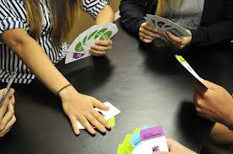
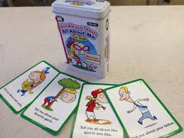
Activities
Get students to relax by playing a group game.
Focusing on a game can relieve pressure to talk.
Relaxed students tend to speak more.

Slide 16

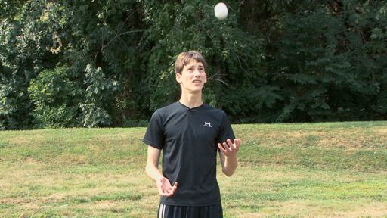
Conversation Partners and scenarios to look out for…
Mixed levels
Bringing the conversation back to simple English can always go deeper again, still inclusive

Slide 17
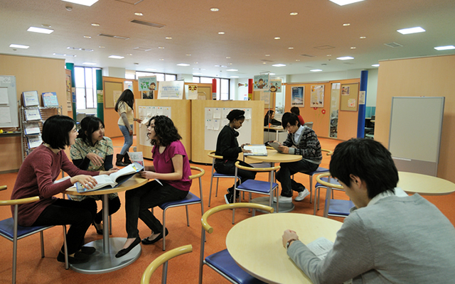
Conversation Partners and scenarios to look out for…
Lots of people
Set others up with a game / topic and they may wait longer if you are busy

Slide 18

Conversation Partners and scenarios to look out for…
Topic you have no clue about get the person to explain it to you

Slide 19
Ideas to get the most out of a Conversation Partner
Responsible for a section
Game with one / conversation with another
Don’t limit them to a certain area / some people are shy and can’t even go to the area

Slide 20
Ideas to get the most out of a Conversation Partner
Themes beginners etc but be careful
Find out if the Conversation partner has any specialist skills and try to utilise them.
Conversation partners that gel well. Different nationalities or the same can be exploited.

Slide 21
Push and Pull Theory
First-year English communication and reading teachers ‘pushed’ their students to go to the World Plaza by giving them interactive speaking projects and tasks to do there, instead of, or in addition to, regular class homework.

Slide 22
Pull
Then, from the middle of the first semester, events were also held in the World Plaza to ‘pull’ students there, such as having regular chat time, lunchtime discussion clubs, movie clubs, a language clinic, and guest speakers. (Croker & Ashurova, 2012)

Slide 23

Relax
Where the environment of a self-access lounge is as relaxed as possible, students are likely to be more willing to communicate (Bibby, Jolley, & Shiobara, 2016) (Krashern, 1982) .

Slide 24

How can we improve partners but still maintain a relaxed atmosphere?
Perhaps increasing self awareness.

Slide 25
Self-awareness questions
Multiple choice:
What best describes you as a conversation partner?
A good listener
A good talker
A fun partner
An educator

Slide 26
Self-awareness questions
Multiple choice:
How much are you talking during the conversation?
Between 100% and 76% of the time
Between 51% and 75%
Between 26 and 50%
Between 0% and 25%

Slide 27
Open-ended questions
Short answer:
What is the most important aspect of being a conversation partner?
What is something a conversation partner must never do?

Slide 28

Other questions or suggestions?
What else could be included?
Suggestions?

Slide 29

Self Awareness role-playing
Management and Conversation Partners
Videos of role-playing

Slide 30

5 scenarios that have occurred
Always make new students feel welcome.
Relaxation helps motivation.

Slide 31

Scenario 1
During slow times, be aware of who is in the room and invite them gently to talk.

Slide 32
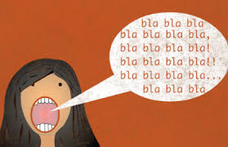
Scenario 2
If you are sitting and talking to other teachers be sure that you are not discouraging potential students from coming to talk.
Notes:
if several teachers are sitting closely together and are quite involved in their own conversations, students may feel that they are interrupting those teachers when approaching the orange sofas.

Slide 33
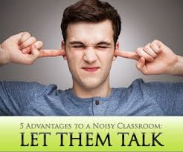
Scenario 3
CPs should try not to dominate the conversation.
The SALC represents one of the few opportunities students have to speak English.
Notes:
In addition, if some students are dominating the conversation, please encourage other students to contribute as well.

Slide 34

Scenario 4
Students should have something that want to talk about but if not, here are a few ideas for talking with the students.
Comment on something you notice: their bag, a book, their glasses, their shoes, etc. This may lead to a conversation.

Slide 35

Scenario 5
Do not push conversation on students if they seem to prefer to sit alone, or simply speak with their friends.
Notes:
If you do, however, overhear students speaking Japanese together, politely remind them that we are trying to practice, and improve, our English in the Global Plaza.

Slide 36

Conclusion
Try to raise self awareness amongst your Conversation Partners
Relax
Adapt/change

Slide 37

Audience Questions or Comments
What ideas have you tried with your conversation partners?

Slide 38

Thank you for listening

Slide 39
References
Bibby, S., Jolley, K., & Shiobara, F. (2016). Increasing attendance in a self-access language lounge. S tudies in Self - Access Learning Journal, 7 (3), 301-311.
Croker, R., & Ashurova, U. (2012). Scaffolding students’ initial self-access language centre experiences. Studies in Self - Access Learning Journal, 3 (3), 237-253.
Krashen, S. D. (1982). Principles and practice in second language acquisition. Oxford, UK: Pergamon.

Slide 40
Contact information
Richard Hill
  richardhillmotoyama@gmail.com
Robert Primeau
  robato.purimo@gmail.com

