Slide 1
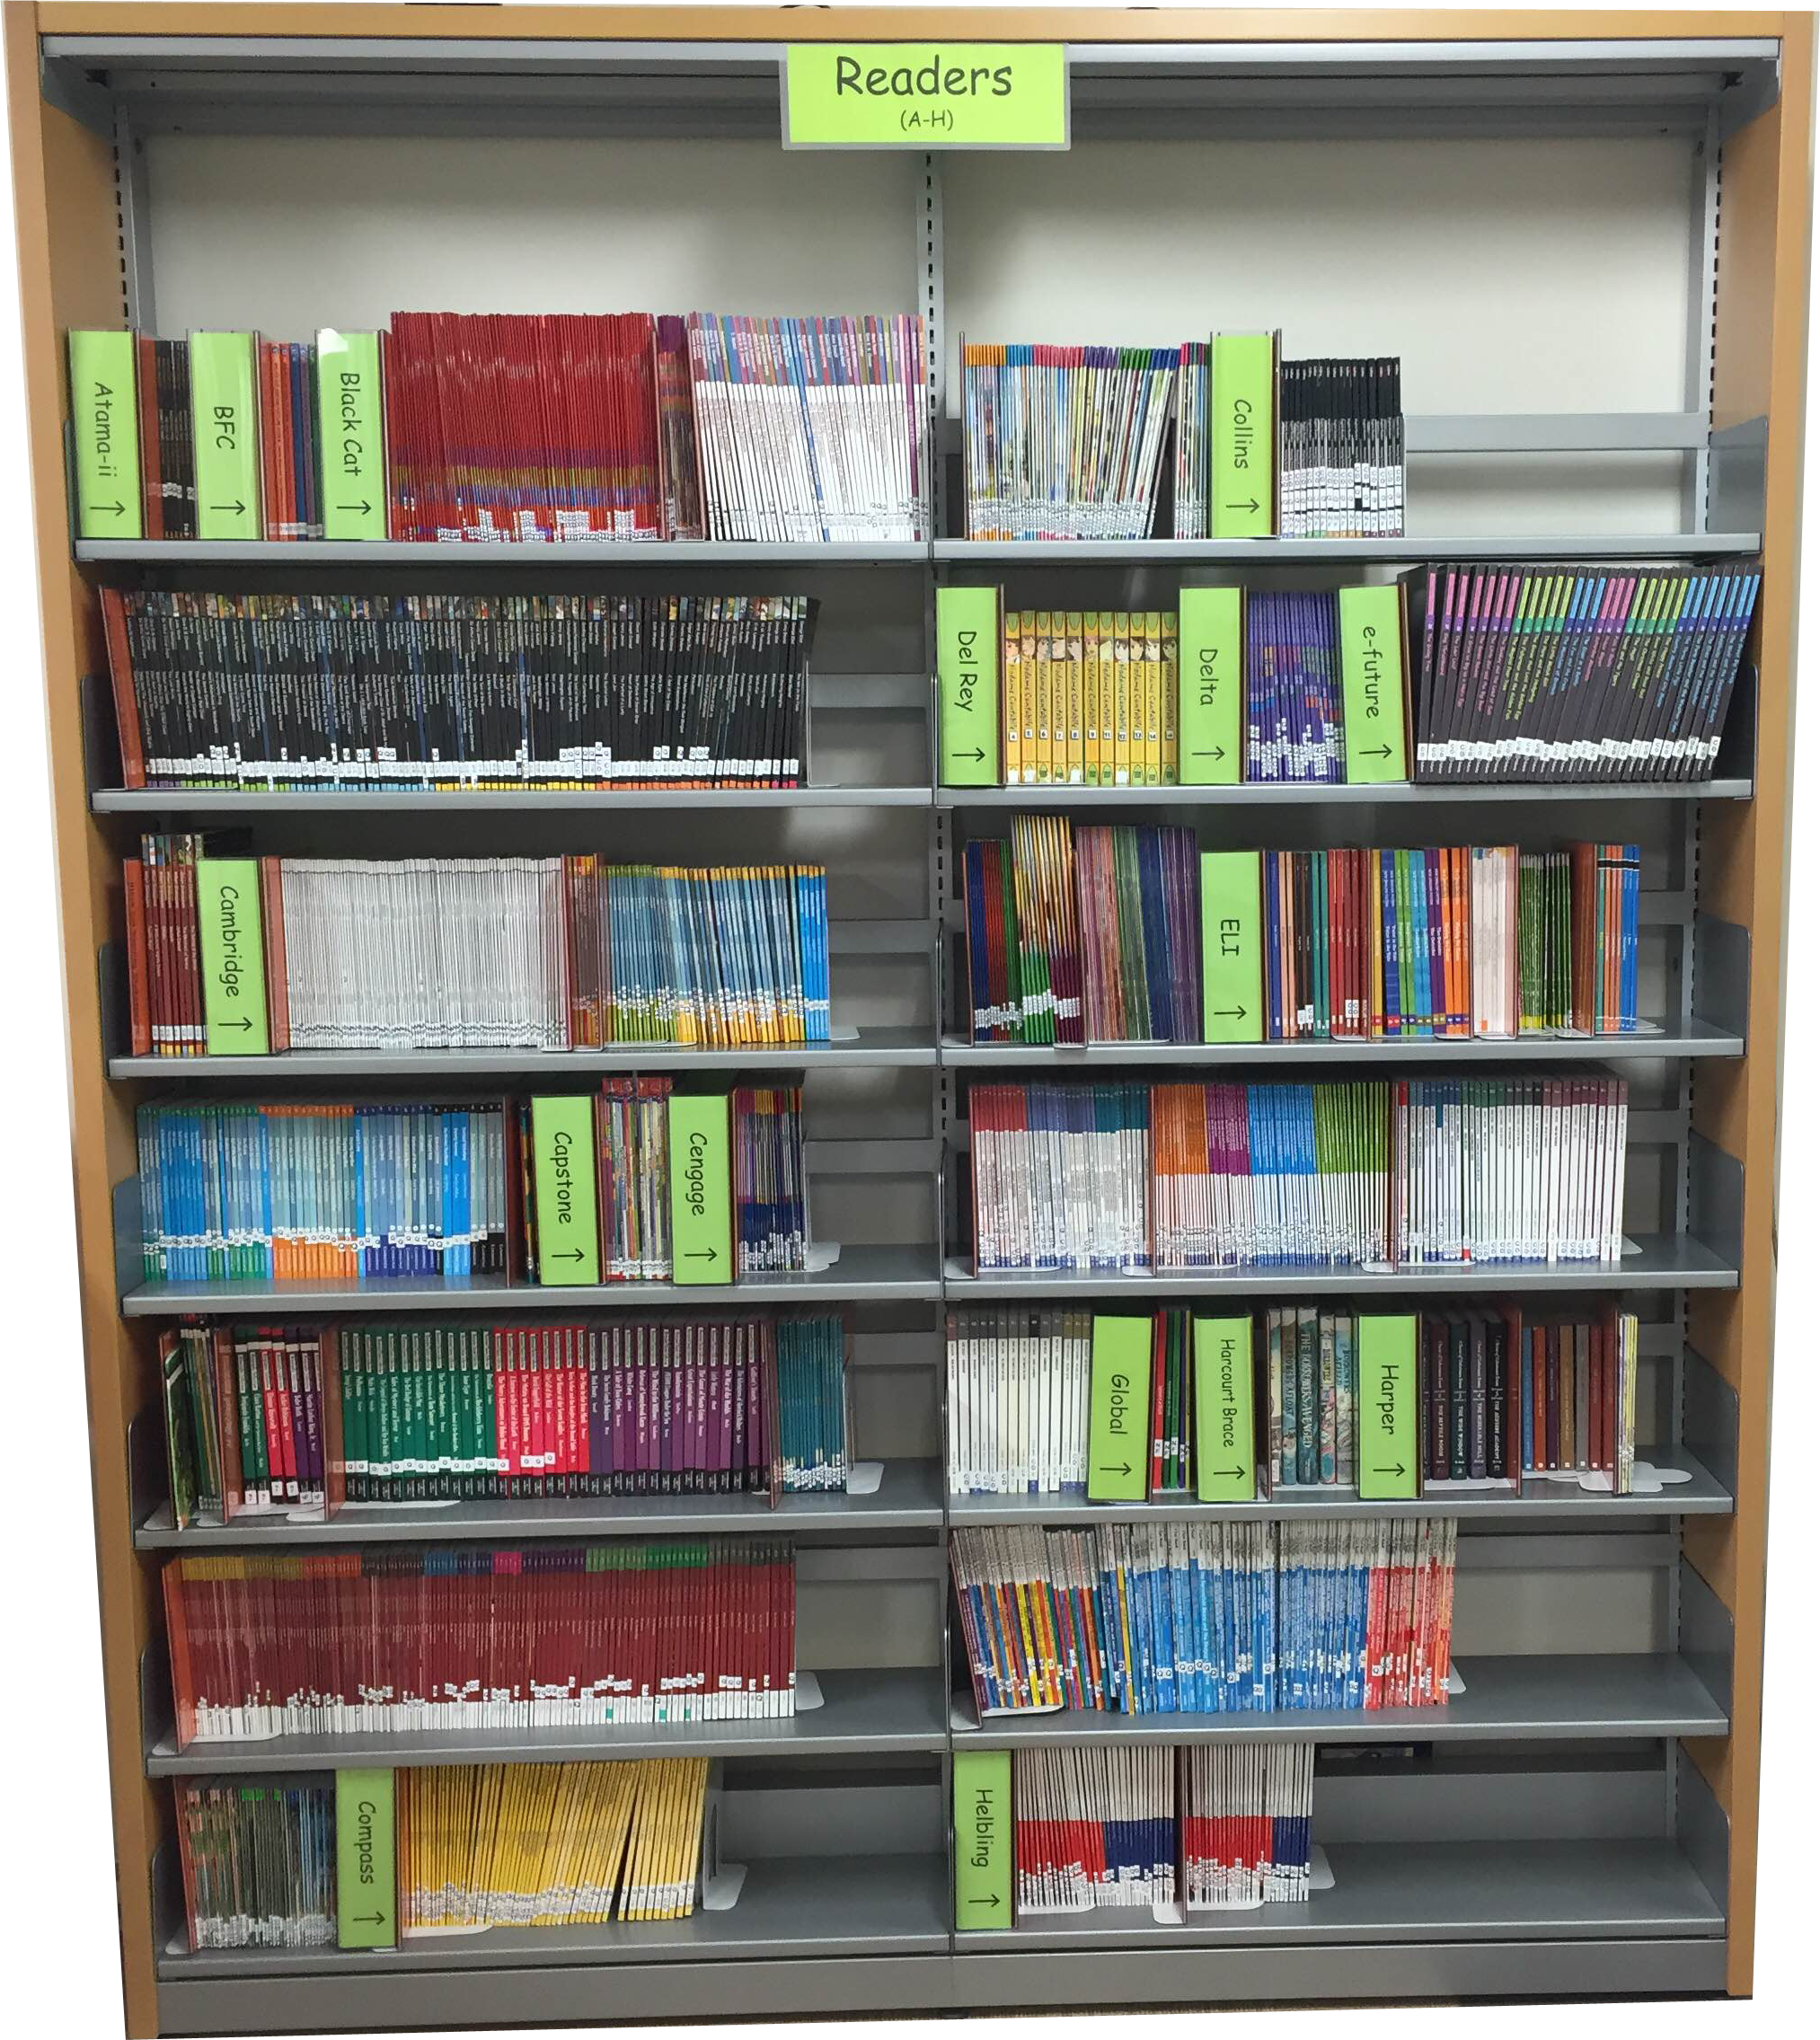
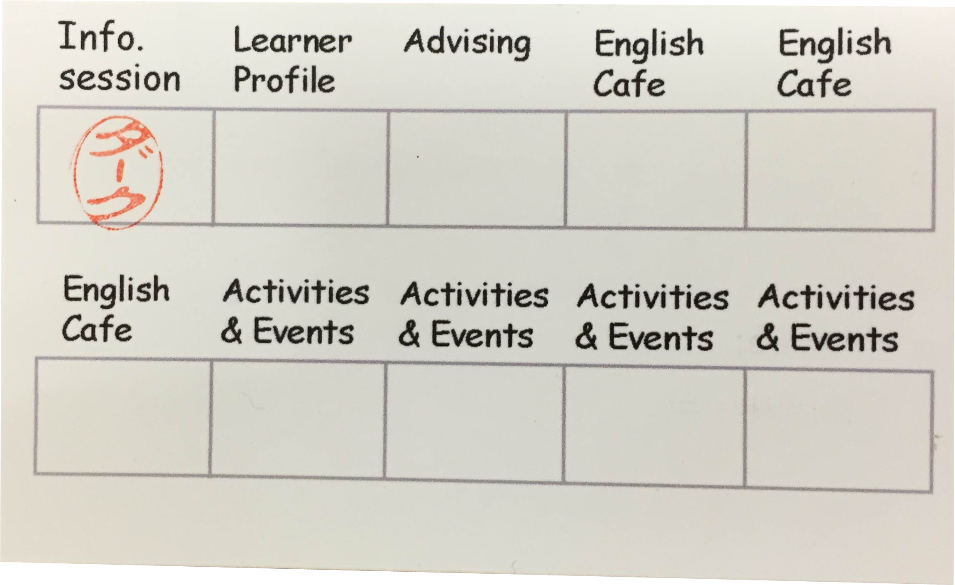
Integrating self-access into two courses via a stamp rally and extensive reading program
Dirk MacKenzie & Brian Nuspliger
Konan Women's University

Slide 2

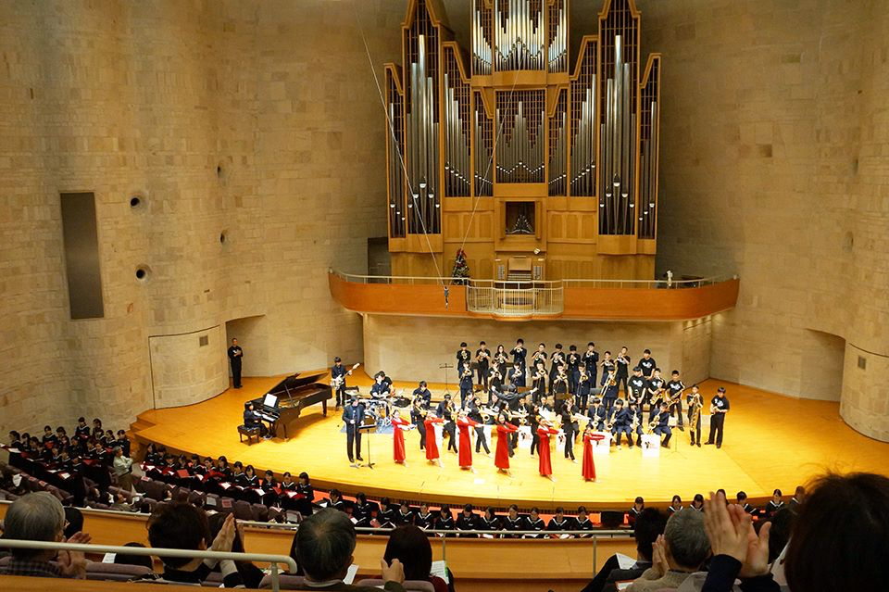
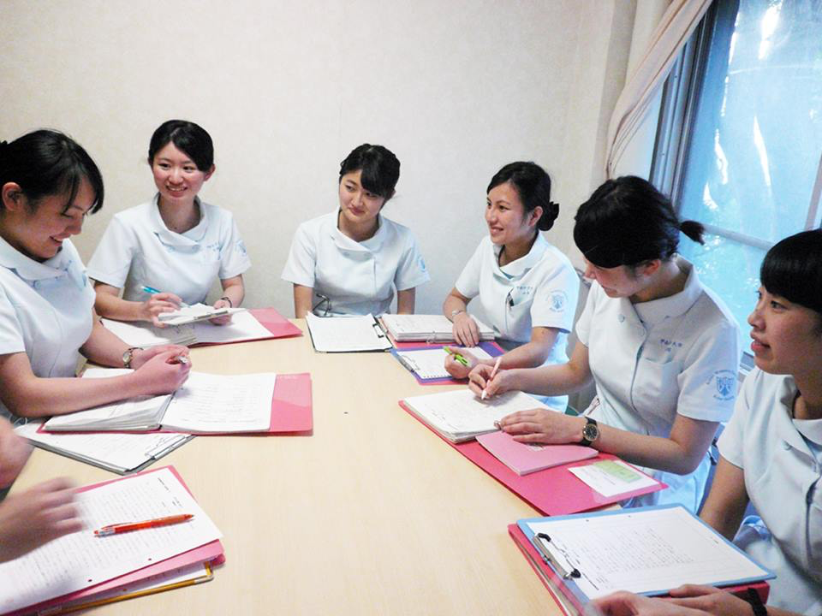
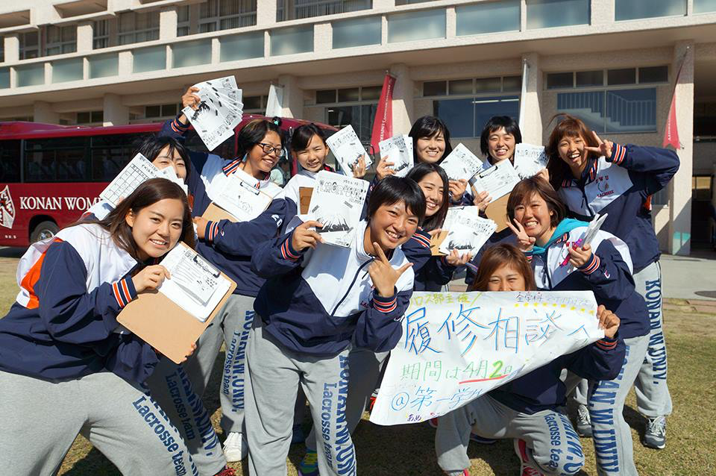

Slide 3
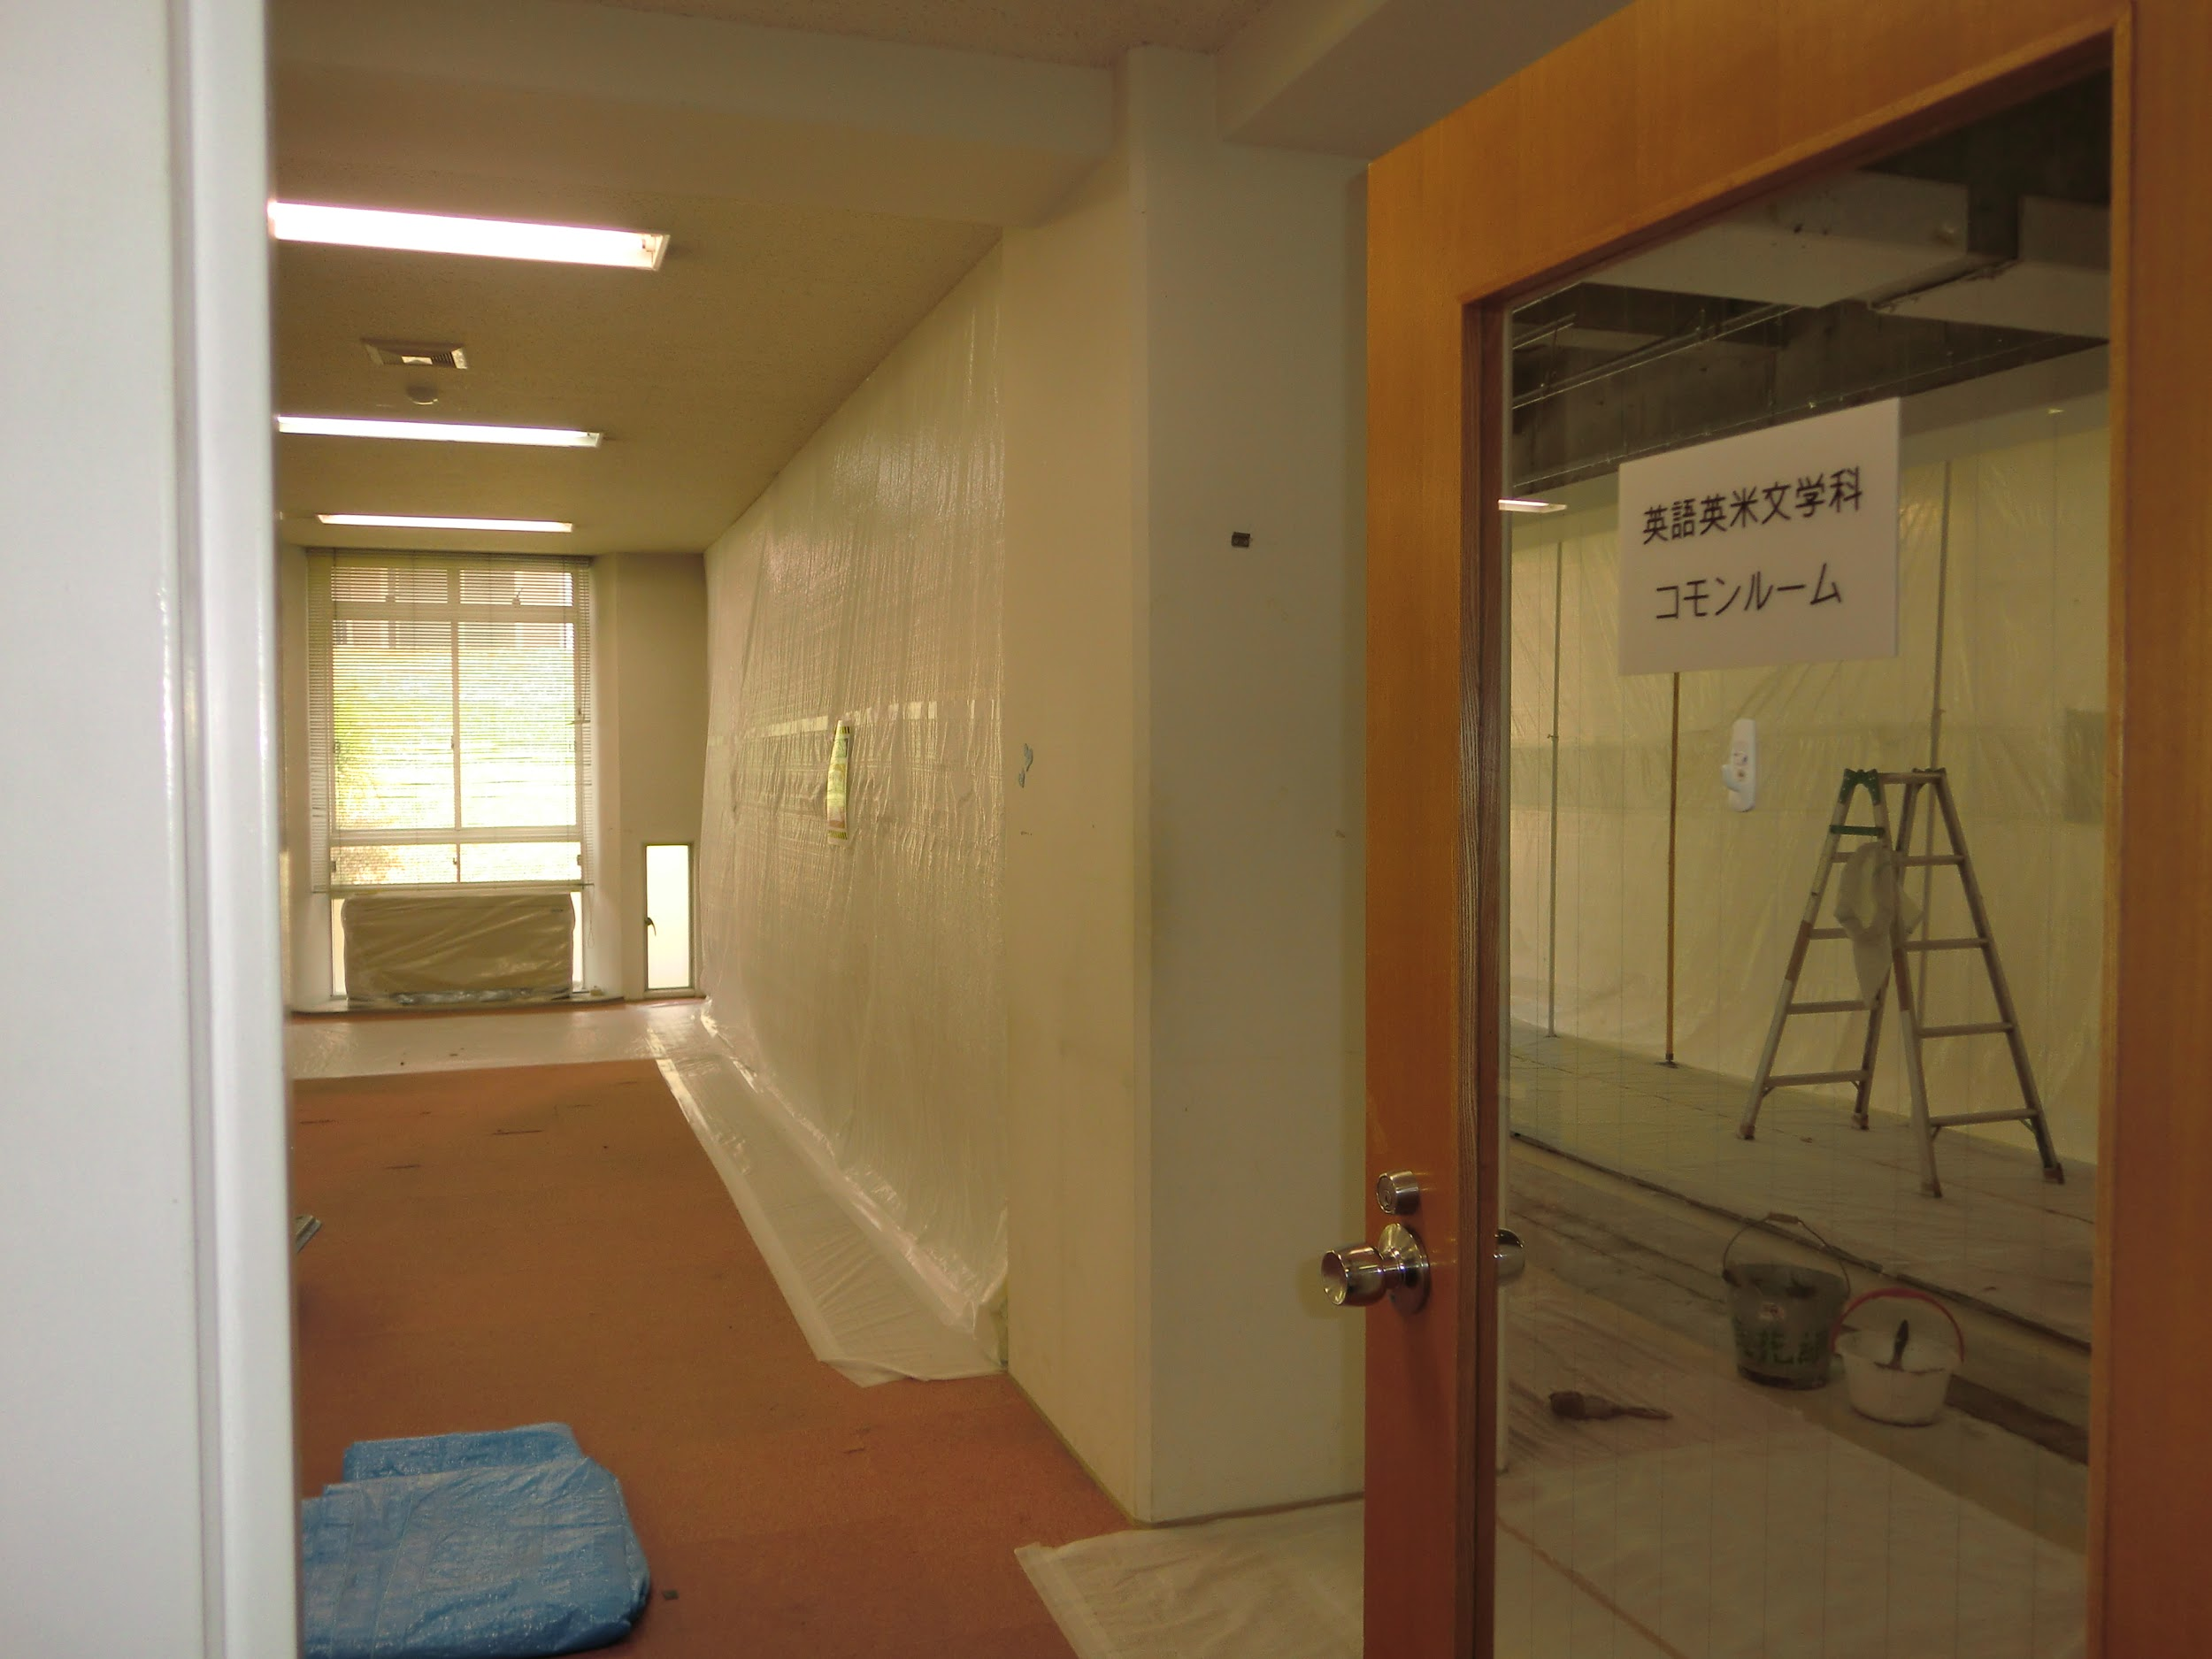
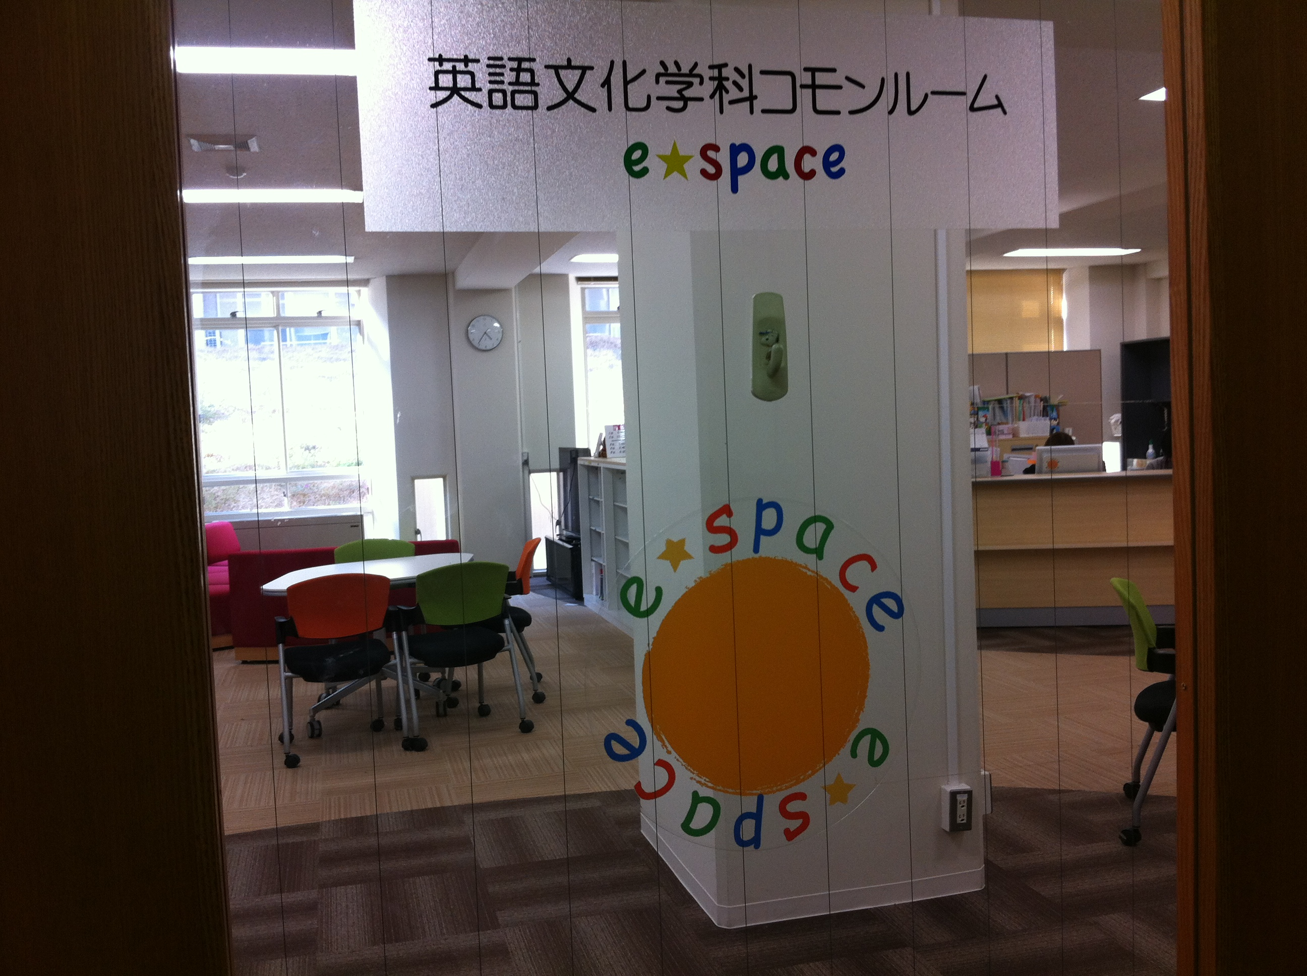
Background
2011
2 lecturer/advisors hired
common room renovated
“e-space” opens
2012
Department name change
New curriculum
New “English Production and Fluency (P&F)” course
Notes:
new curriculum focus on fluency and autonomy

Slide 4
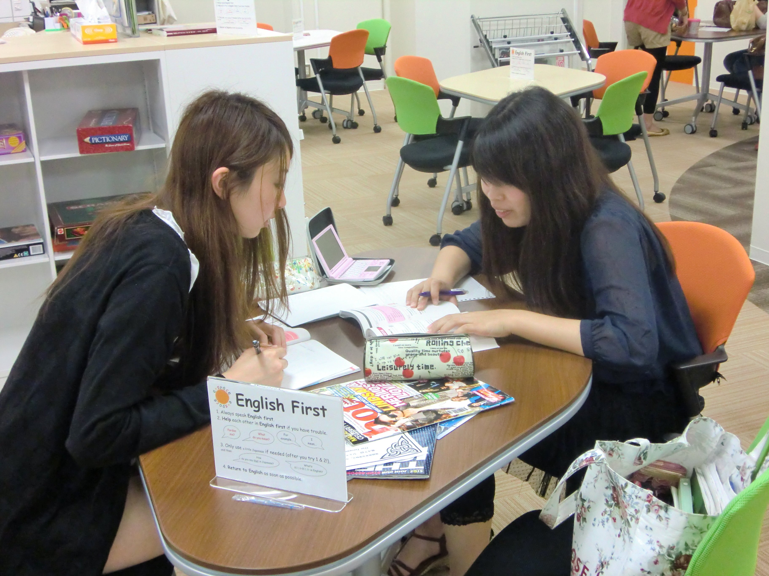
Background, cont.
2013
e-space component written into P&F course outline
20% grade allotment suggested
2014
20% e-space/ER component mandated
Notes:
confusion about who was responsible

Slide 5
e-space component
Course | Spring | Fall
P&F I/II | Stamp rally | Extensive reading
P&F III/IV | Extensive reading | Stamp rally

Slide 6

Stamp rally

Slide 7

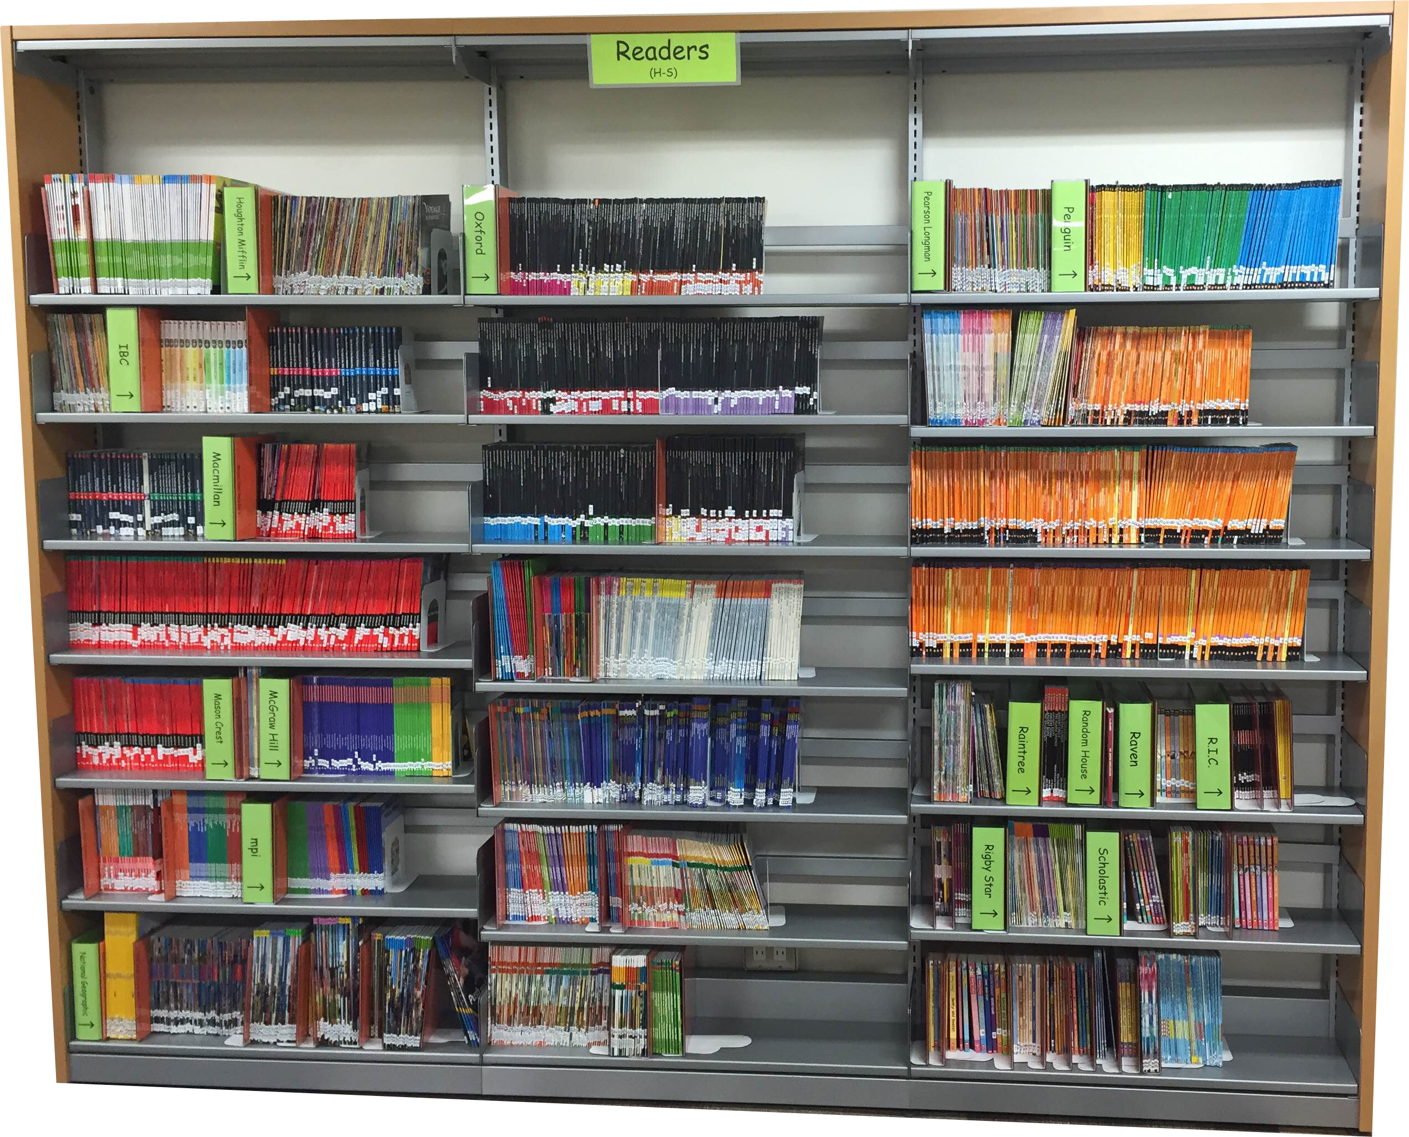
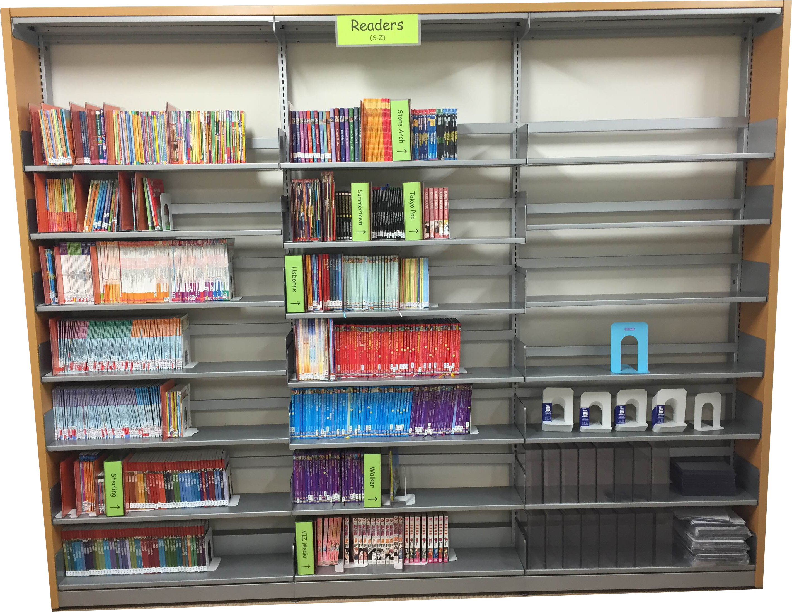
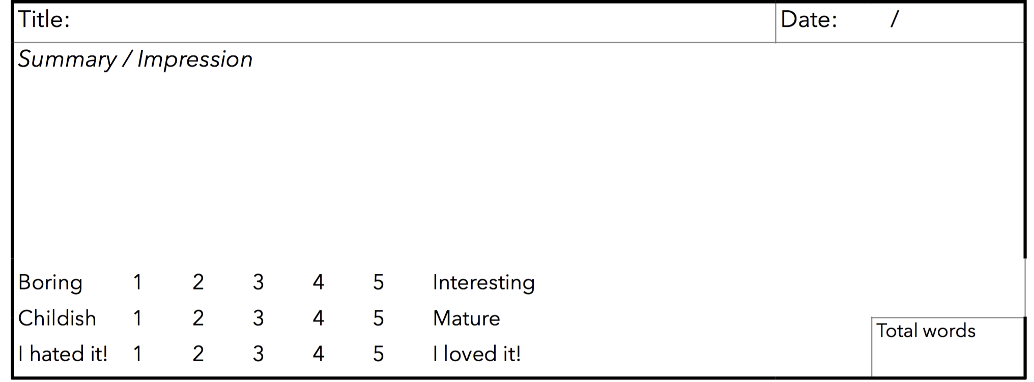
Extensive reading
7,158 readers
Target: 50,000 words (70,000 advanced)
Quizzes on mreader.org
Summary/impression forms (2nd-year only)
Notes:
Just ordered 1319 more!

Slide 8
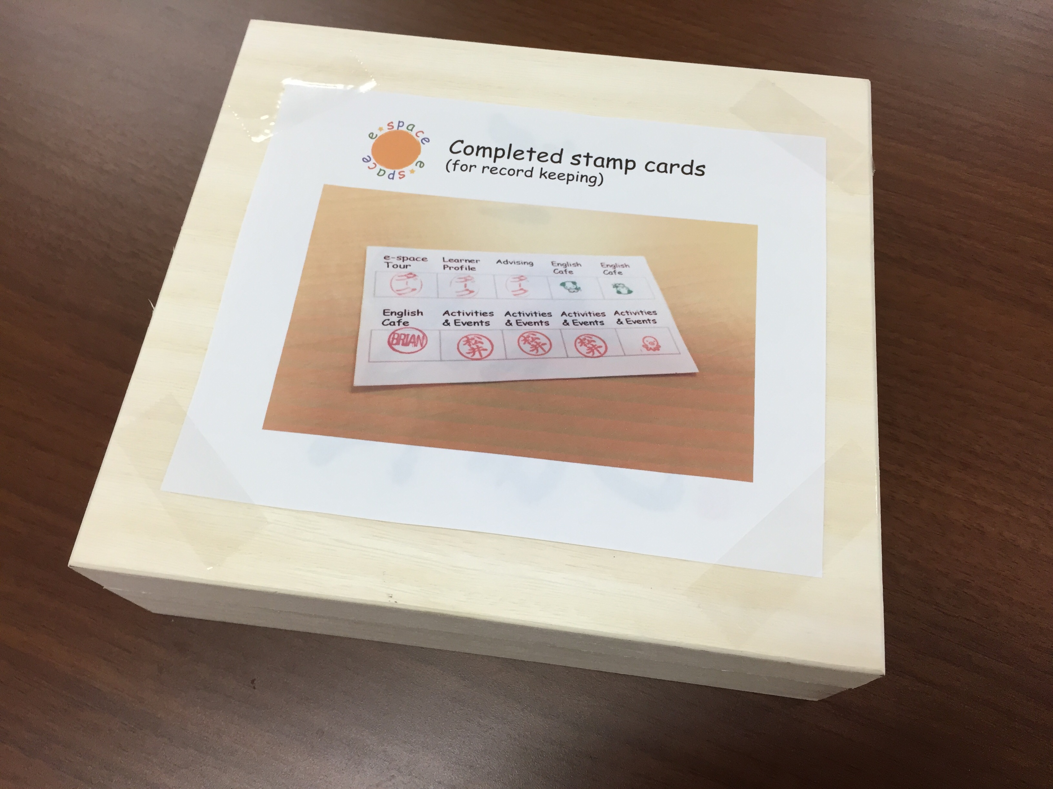
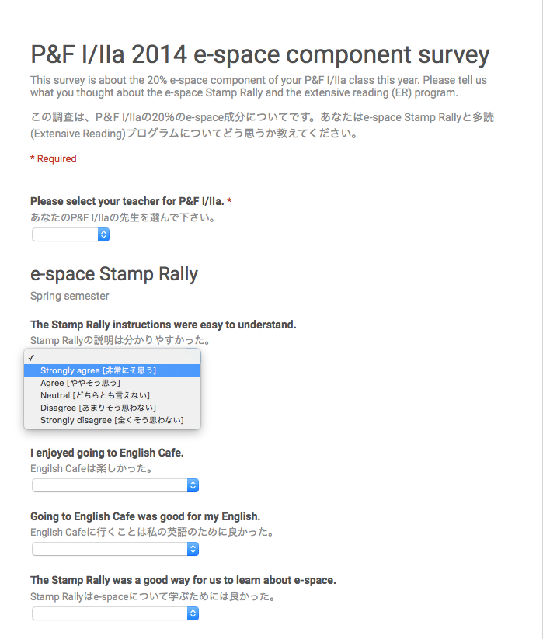
Data collection
Stamp cards
mreader.org data
Student survey
Advising numbers
English Cafe numbers

Slide 9
Student survey
 | Sections | Students | Responses | Rate
1st years | 8 | 127 | 97 | 76.4%
2nd years | 8 | 125 | 56 | 44.8%
Total | 16 | 252 | 153 | 60.7%
Notes:
Survey was bilingual

Slide 10
Results: Stamp cards submitted

Slide 11
Results: Stamps received

Slide 12
Results: mreader.org
Words read
Quizzes taken
Words/quiz
Notes:
look at book borrowing over time?

Slide 13
Results: mreader.org (2014)
1st years: % of target read
Overall: 86% of target words read
Actual
Target
2nd years: % of target read
Notes:
look at book borrowing over time?

Slide 14
Results: Student survey
The Stamp Rally was a good way for us to learn about e-space.
Advising was helpful to me.

Slide 15
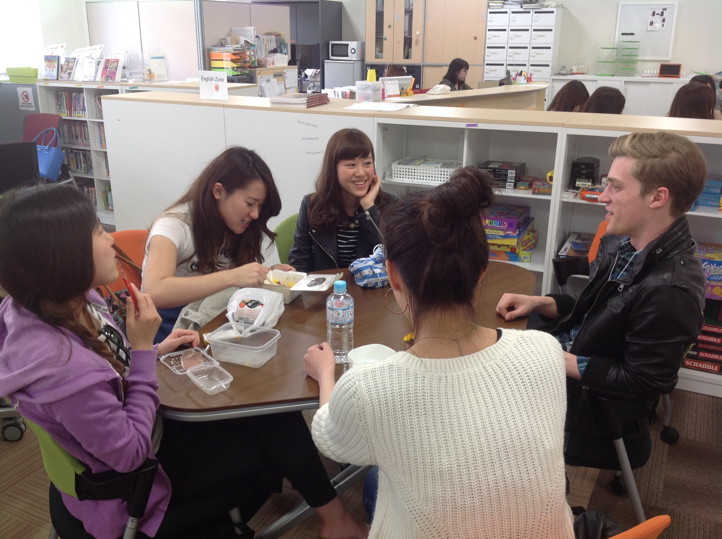
Going to English Cafe was good for my English.
I enjoyed going to English Cafe.

Slide 16
It was easy to find books at my level in e-space.
M-Reader quizzes were a good way to check that we were reading.

Slide 17
I enjoyed reading.
Doing ER was good for my English.
I want to continue to do ER in the future.

Slide 18
Results: English Cafe numbers
# of participants
Notes:
numbers include nanjo staff
overlapping numbers

Slide 19
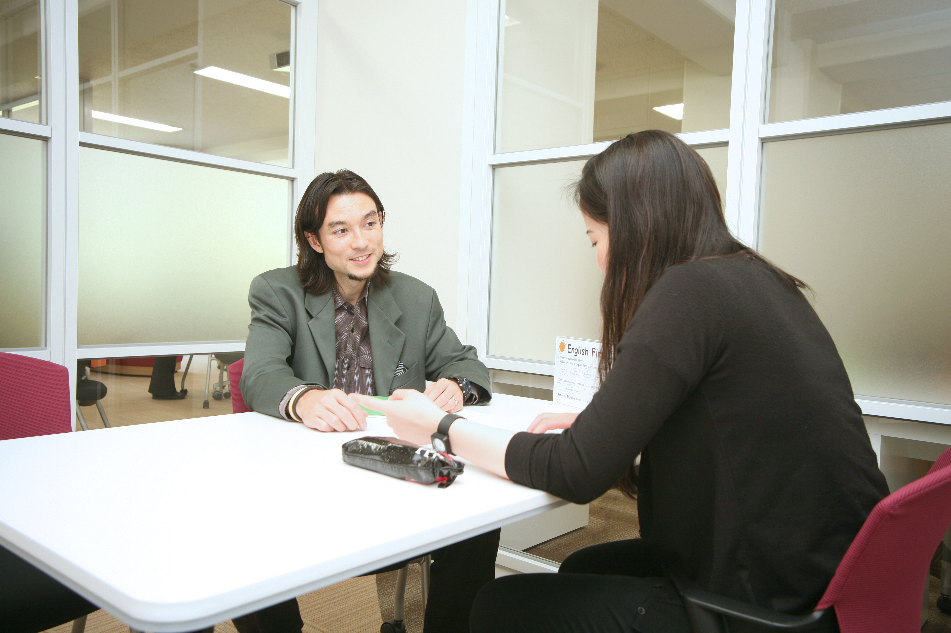
% of available sessions booked
Results: Advising numbers

Slide 20
# of advising sessions per student
# of advising sessions

