Slide 1
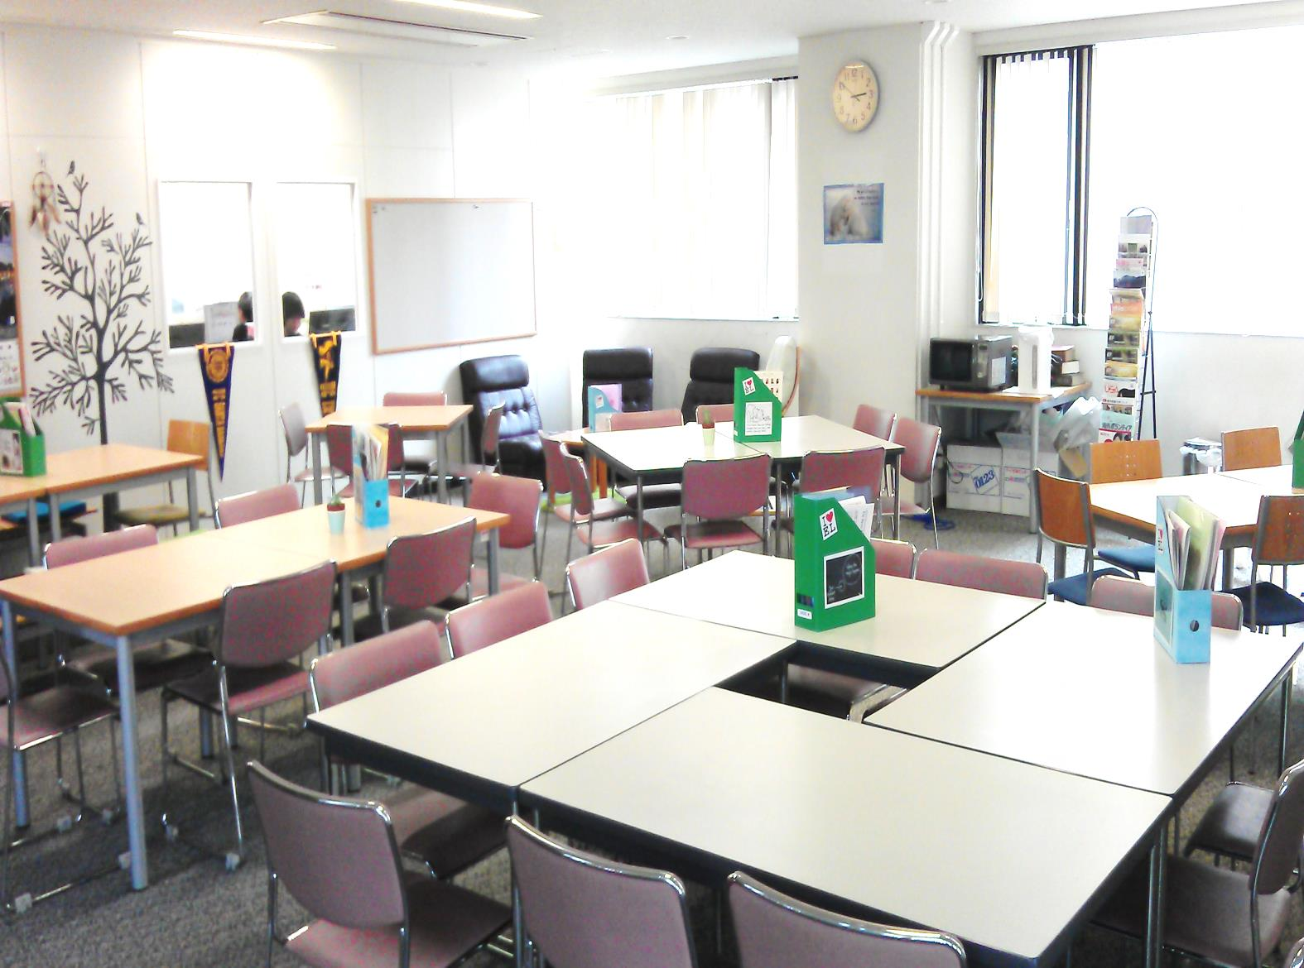
Part 1
What is the English Lounge?

Slide 2
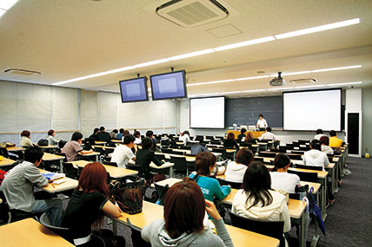
A lecture or a lesson?

Slide 3
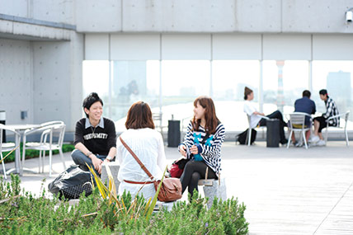
A place students enjoy themselves?
Notes:
japanse

Slide 4
Lounge is a link in between.
Lecture
English
Lounge
Everyday life
Notes:
先生主導の英語学習から学生主導の英語学習

Slide 5
Lounge transforms students.
Passive
learner
Active
Learner
Independent
learner
Notes:
先生主導の英語学習から学生主導の英語学習

Slide 6
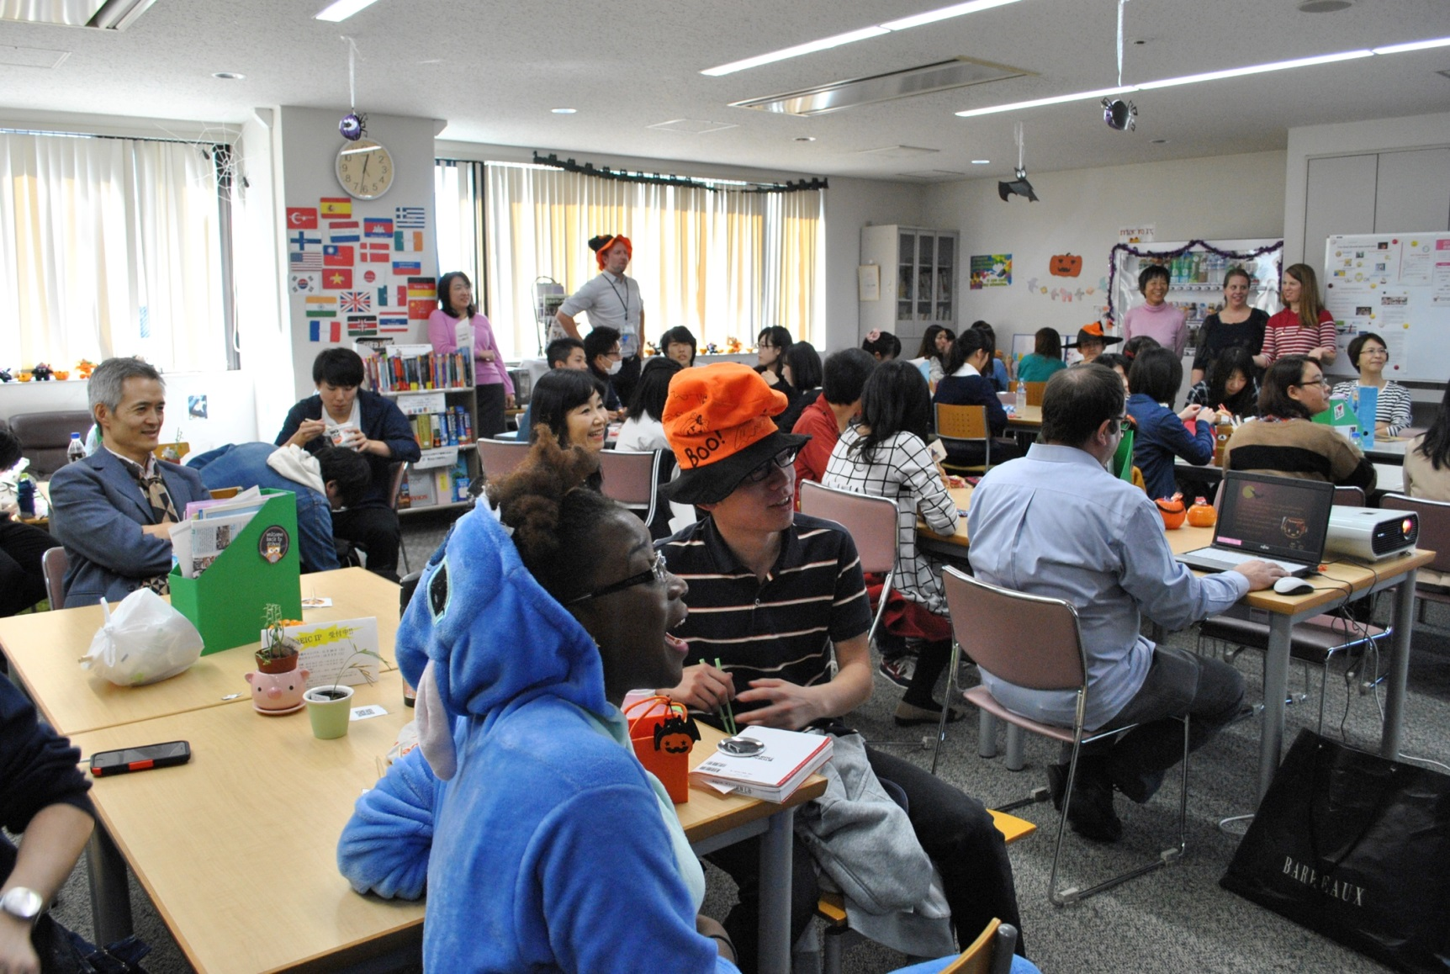
Part 2
How do we run our English Lounge?
Notes:
ラウンジに人を集めるためにどんなことをしているか

Slide 7
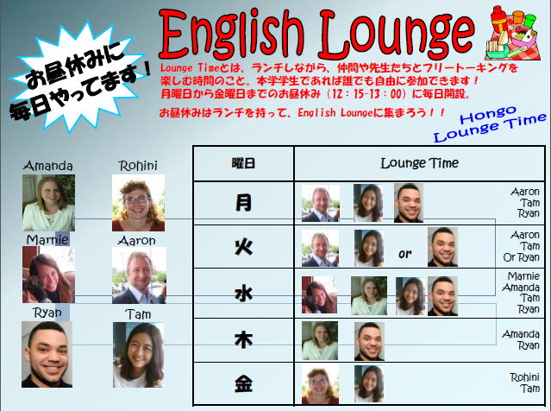
Teachers as facilitators

Slide 8

Events as a motivator

Slide 9
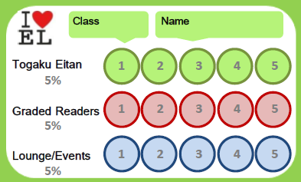
Stamp card as an incentive

Slide 10
Part 3
What is the problem?
Passive
Learner
Active learner
Independent learner
?
?
Notes:
現状の問題点 independent learnerになっていない、授業になっちゃった 補講みたい

Slide 11
20%
10%
15%

Slide 12
Reasons for coming to the Lounge
Notes:
How do we solve this problem?

Slide 13
Part 4
How do we encourage students to be independent?
The skill they want to improve most

Slide 14
Six possible ways
1. Clarify the purpose of the lounge
2. Teach methods of self-study
A book by a TOEIC trainer

Slide 15
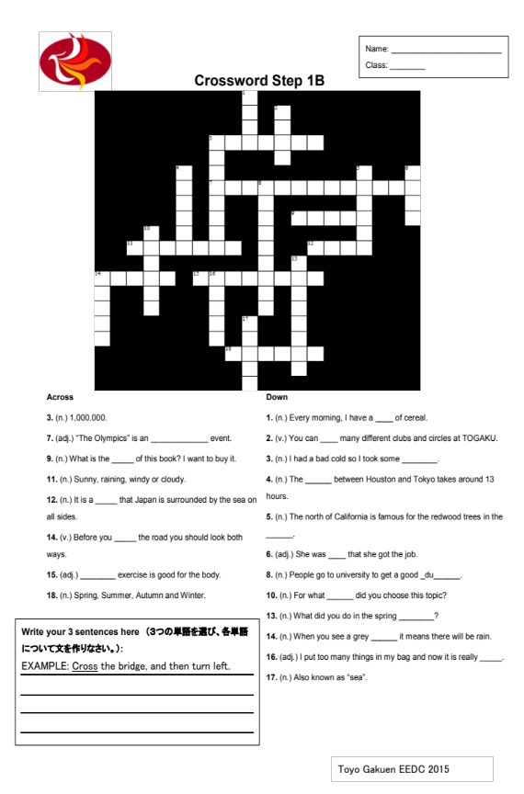

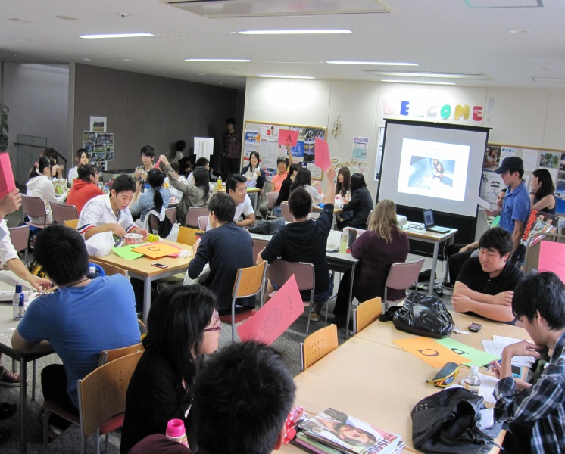
3. Review the stamp card system

Slide 16
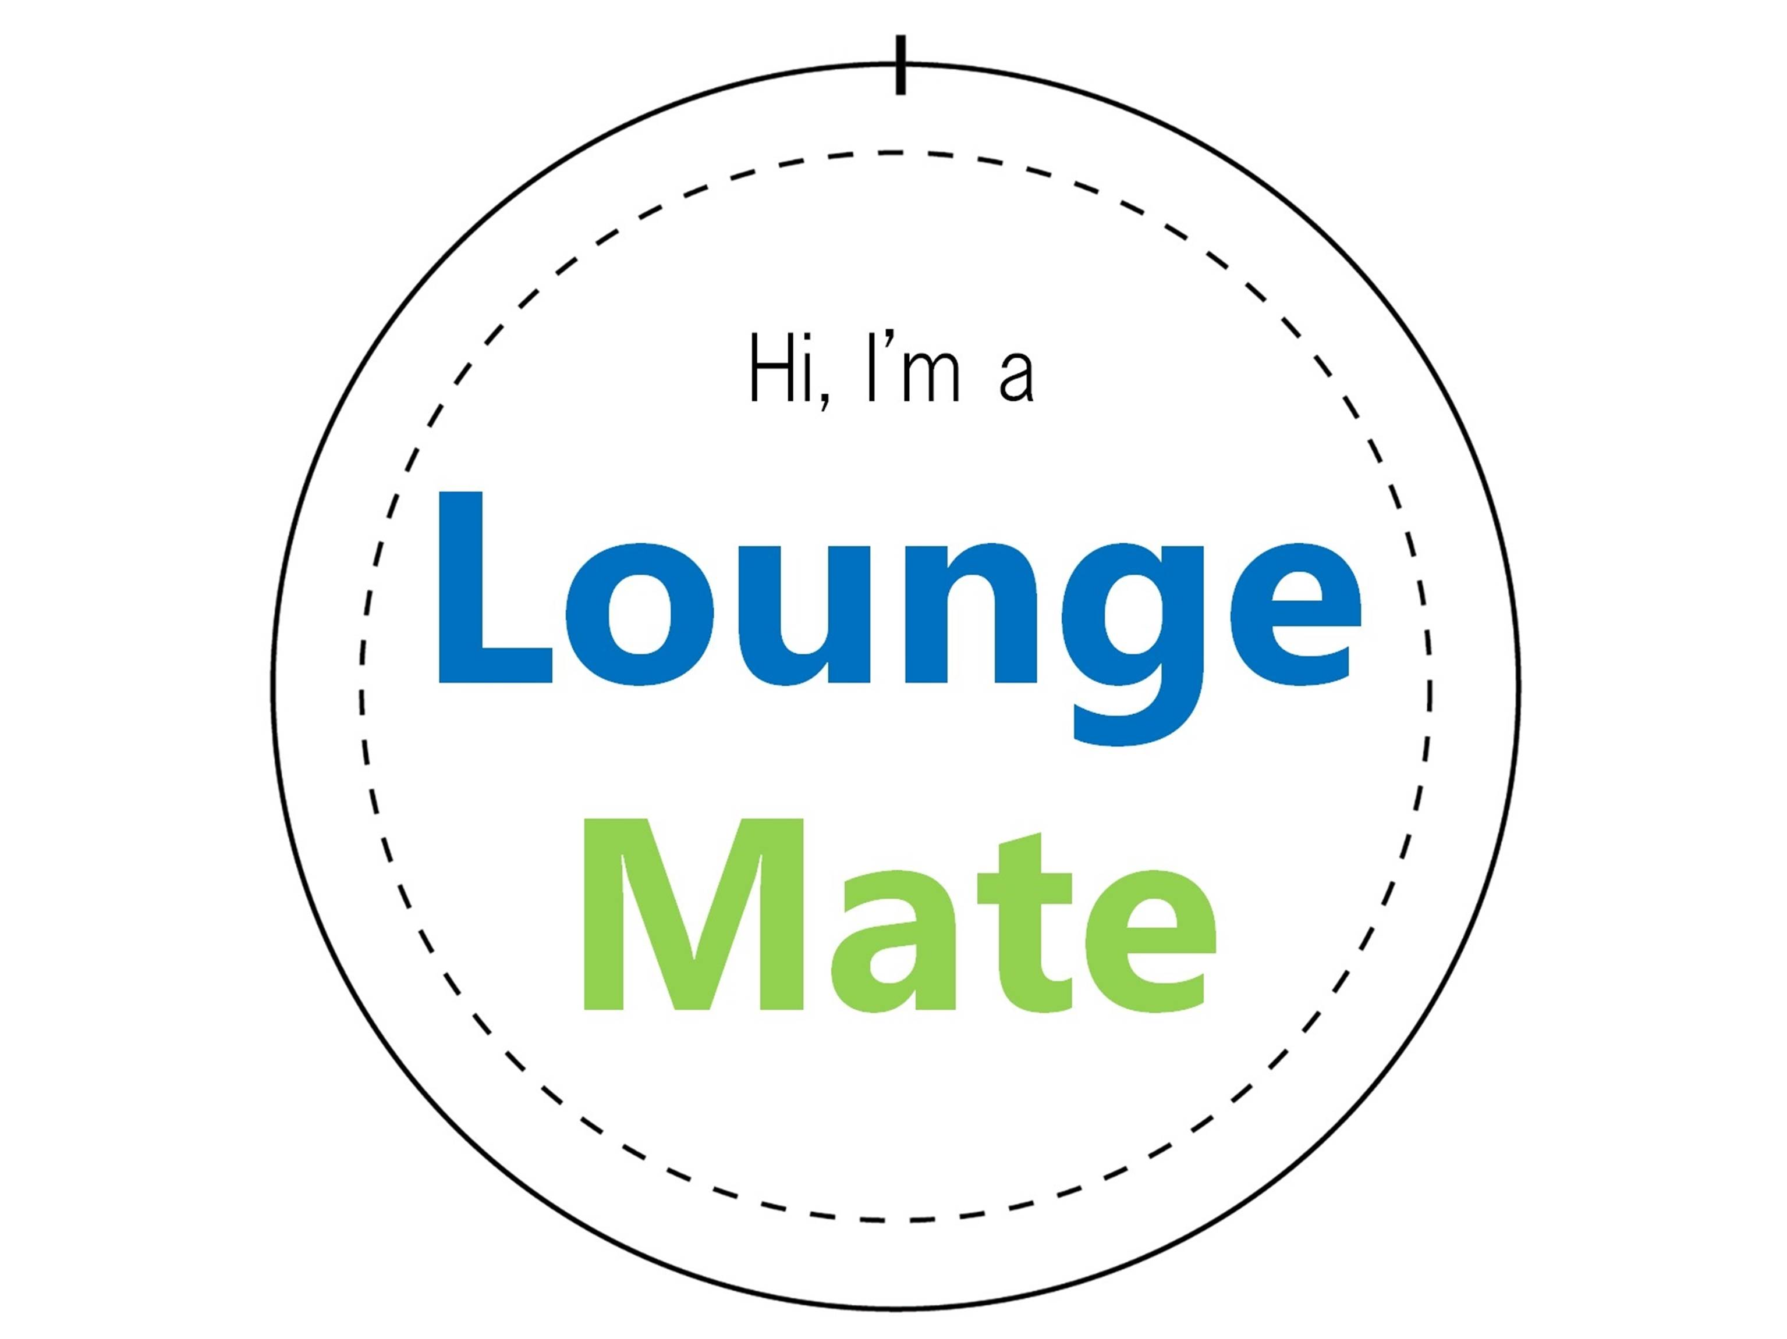
4. Organize peer supporters

Slide 17
5. Compile a “Lounge Phrasebook”

Slide 18

6. Hold workshops on life skills
‘s program

Slide 19
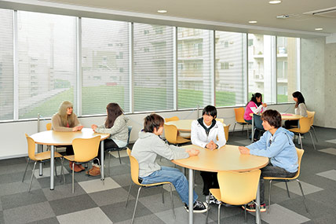
Part 5
Where do independent learners go?

Slide 20

Thank you for listening!
keiko.omura@tyg.jp

