Slide 1

English World: An English Space for Elementary School Students
Clair Taylor

Slide 2
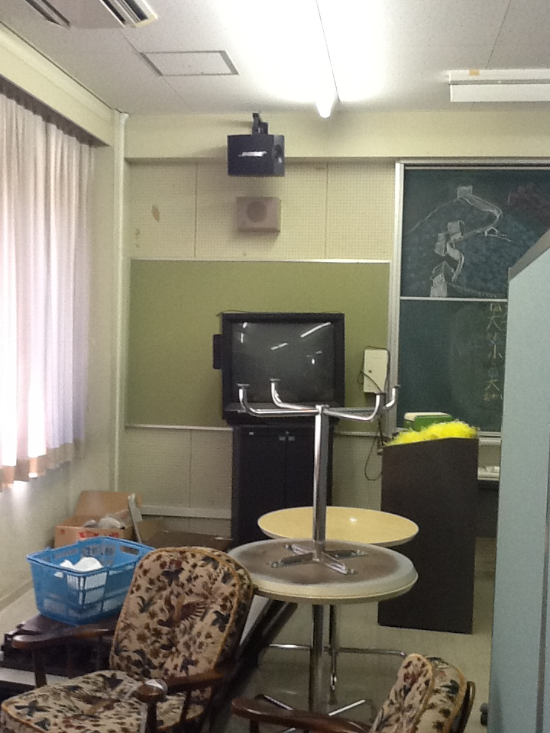
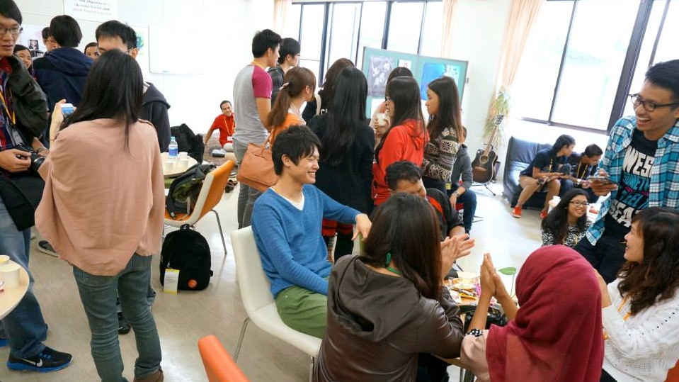
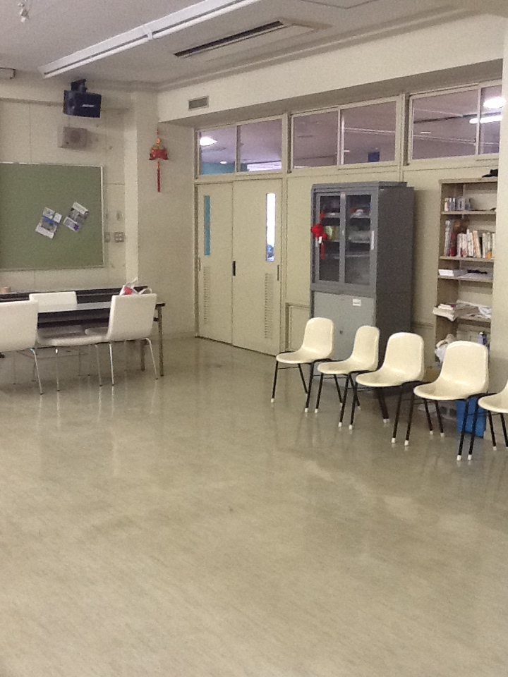
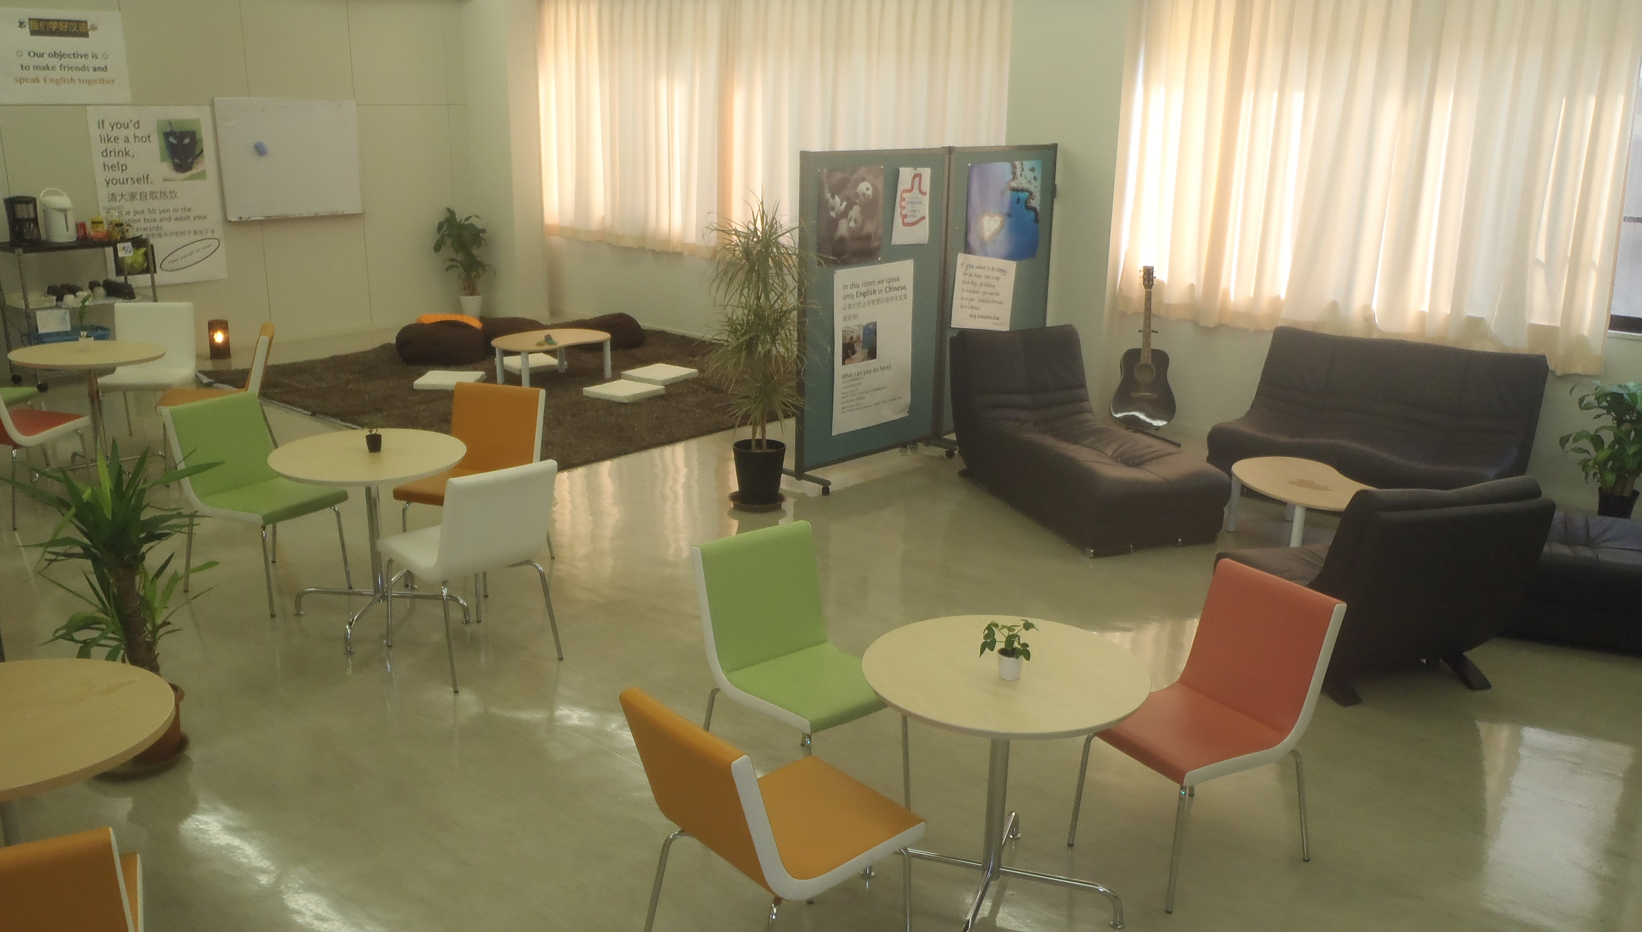
GSGU Lounge
(before)
GSGU Lounge
(after)

Slide 3

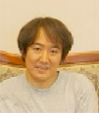
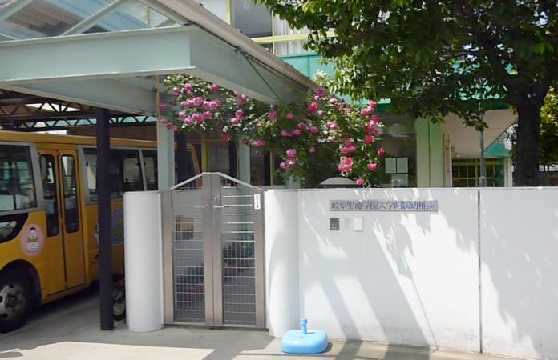
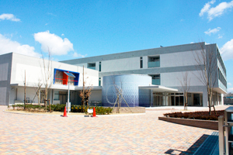
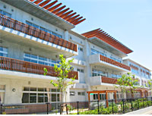
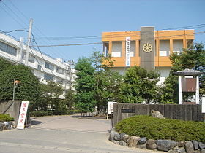
GSGU Affiliated Schools
Takahiro Haga
Center for
Educational Research
and Training
Kindergarten
Junior High School
Elementary School
High School

Slide 4
Characteristics / Features of an
English Conversation Lounge
Opportunities to use English
Free, natural conversation
Fun
Cultural contact / experiences
Community
Autonomy
Effortless learning
Language policy
Open doors
Human-centered design
Support staff

Slide 5
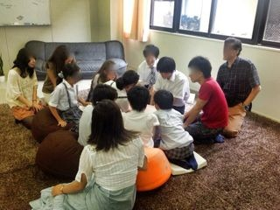
Getting the Project Off the Ground
Discussions
Children’s visit to the university lounge
Discussions
Plans and purchases
Training volunteers
Facebook group (later LINE)
Opening Ceremony
English World starts
Website created
Ongoing training / purchasing

Slide 6
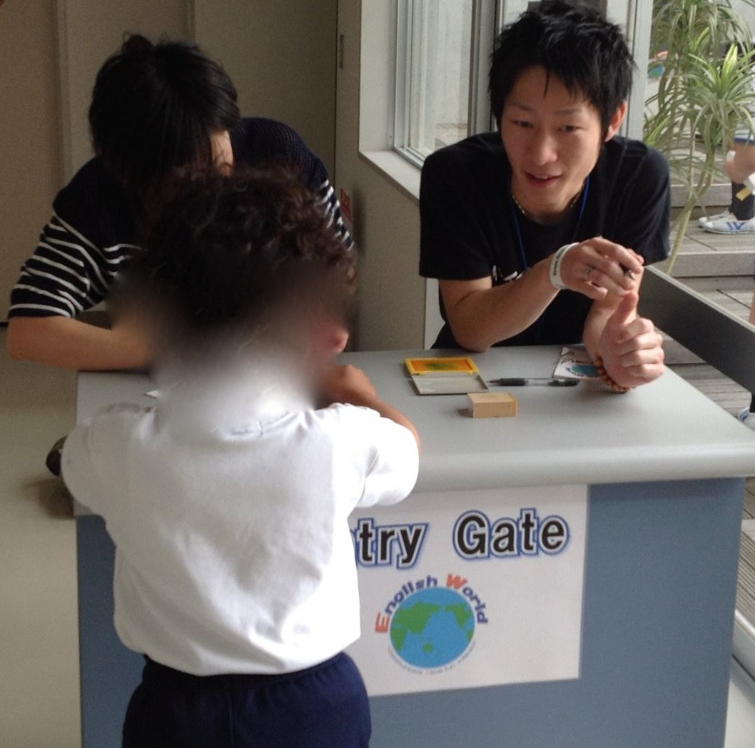
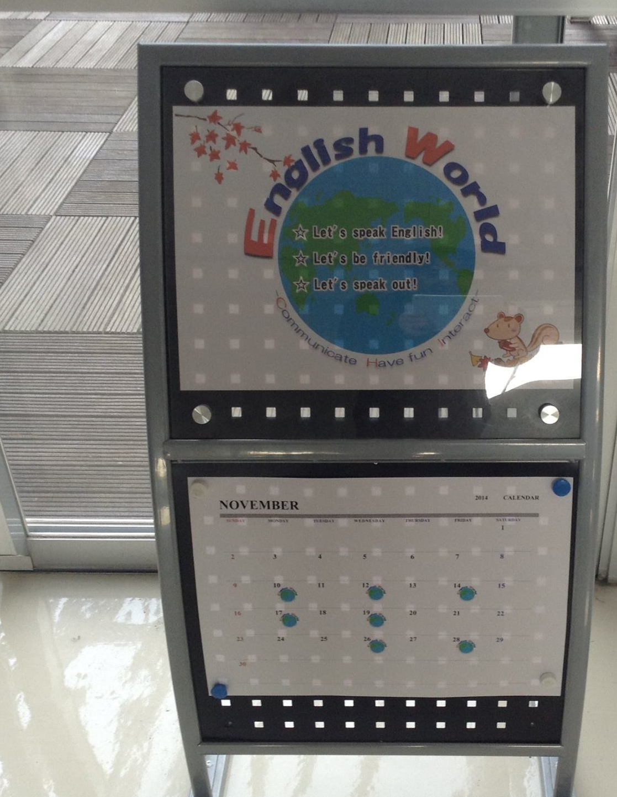
English World
Entry Gate

Slide 7
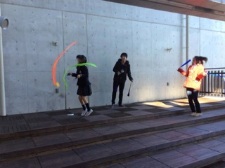
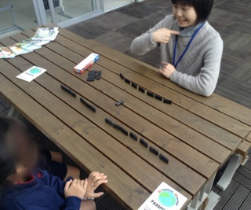
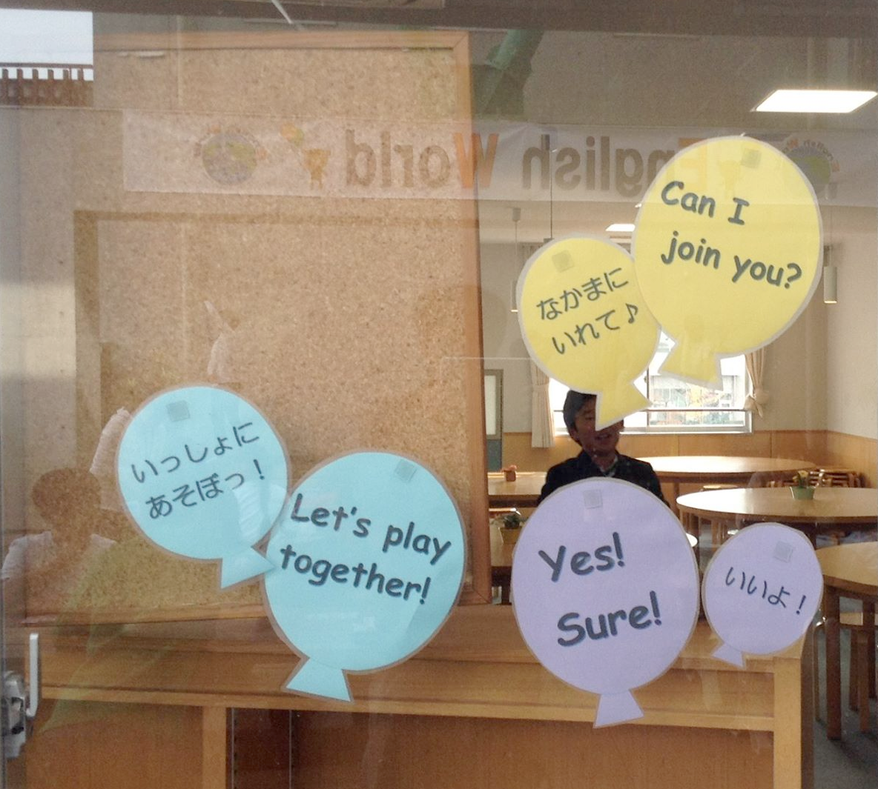
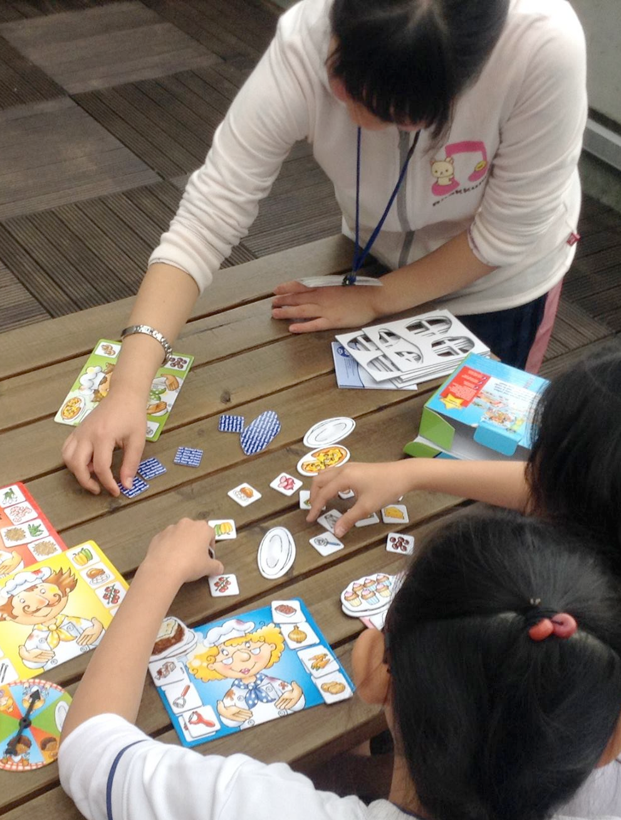

Slide 8
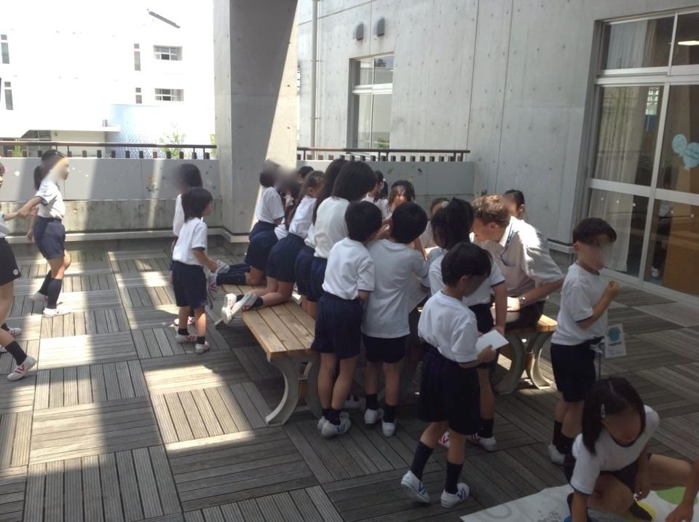

Slide 9

EW Song
English World
English World
English World
English World
Let’s speak English
Let’s be friendly
Let’s speak out
In English World

Slide 10
EW Training
Background
(Japanese)
Rules /
Policy
(Japanese)
Theory and Practice
(English)

Slide 11
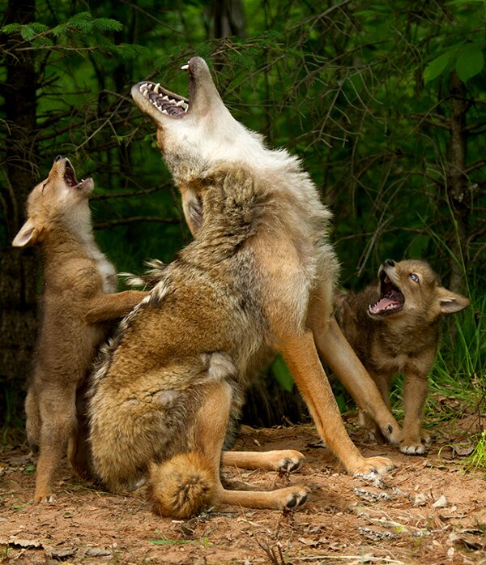
Role Models
http://imgur.com/gallery/W1GvXw4
EW Training

Slide 12
Good Role Model
Speaks English
Feels it’s natural and normal to speak English
Is comfortable speaking English
Thinks English is easy
Uses English with other Japanese
Reads English
Is comfortable with western traditions like using first names
Bad Role Model
Speaks Japanese
Feels only ‘special’ or ‘clever’ people can speak English
Is not comfortable speaking English
Thinks/says English is difficult
Doesn’t read English
Is not comfortable with western traditions like using first names
EW Training

Slide 13
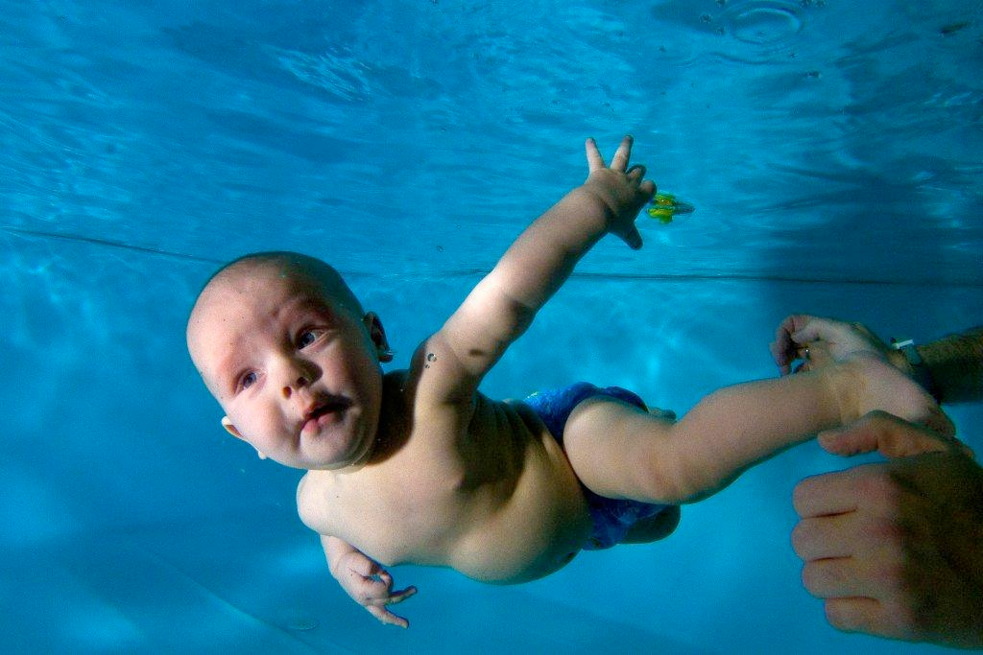
Immersion
https://www.flickr.com/photos/grutho/8465256186
EW Training

Slide 14

Raspberries! Who needs raspberries?
Cheese! I need cheese.
Do you need tea?
http://www.englishbooks.jp/catalog/product_info.php/shopping-list-p-27630
EW Training

Slide 15

Jenga
Slowly! Slowly!
Gently!
Whose turn is it? Is it my turn?
It’s wobbling! Oh no!!
https://www.flickr.com/photos/chrish_99/8524906705
EW Training

Slide 16
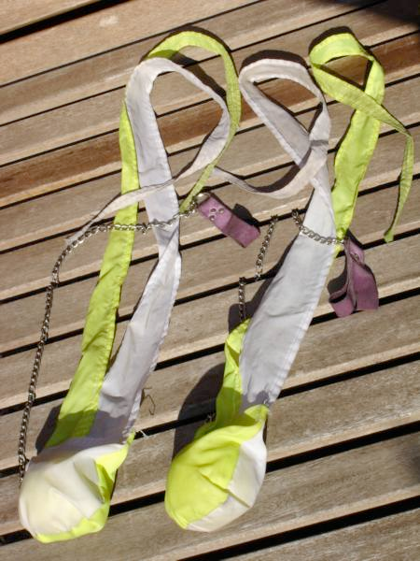
Poi
Draw a circle.
Go over and under, over and under.
Like a helicopter.
Alternate - go right then left.
Walk and do poi at the same time.
https://commons.wikimedia.org/wiki/File:Comet-Poi.jpg
EW Training

Slide 17
Conversation
Do you like...?
Do you have ...?
Do you come to school by bus?
EW Training

Slide 18
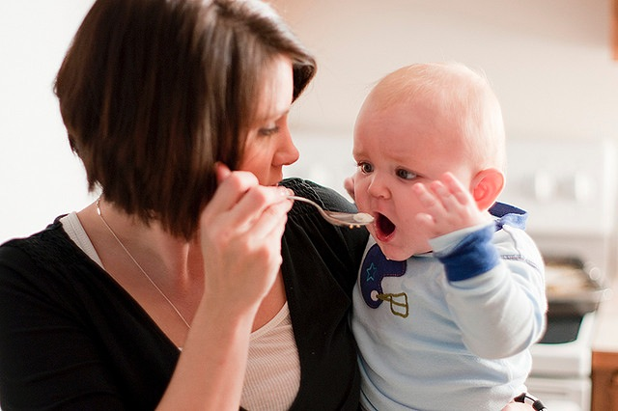
Feed language!
https://www.flickr.com/photos/brianauer/3363070904
https://creativecommons.org/licenses/by-nc-nd/2.0/
Can I have a go?
Please!
It’s my turn!
Your forgot your passport.
Whoops!
Sorry!
EW Training

Slide 19

Racist language
Swearing
EW Training

Slide 20
Research
Ongoing research:
Action research - volunteer training
Future research?
Beneficial effect(s)
- beliefs / WTC / motivation /
ability

Slide 21
More information
http://mooc.ha.shotoku.ac.jp/es/
Creating English Spaces for different educational settings: English spaces at GSGU kindergarten, elementary and junior high school
www.academia.edu/19569431

