Slide 1
Evaluating a self-access centre - options and challenges
Katherine Thornton, Otemon Gakuin University
JASAL Forum 2014 (JALT)
Notes:
Evaluating a self-access centre - options and challenges
One of the most contentious and challenging issues in self-access management is that of evaluation. With a fluid user base and a seemingly endless number of variables, how can the contribution a centre is making be effectively evaluated. This presentation will address a number of options available to SAC managers and give an example from the presenter’s own context, a self-access centre that opened in April 2013.

Slide 2
OUtline
Why evaluate?
What to evaluate?
How to evaluate?
Challenges in evaluating SACs
An example: English Café at Otemon

Slide 3
Why evaluate a self-access centre?
To check whether the centre is meeting learner needs
Identify areas for improvement
Provide feedback for staff (job satisfaction)
To check whether the centre is meeting institutional goals
To account for existing funding
To secure further funding
Promote understanding and support for SALL among stakeholders

Slide 4
What to evaluate?
Efficiency & Effectiveness (Gardner & Miller, 1997)
Efficiency
Quality of management – decision-making process & systems
Value for money – staffing
Value for money – equipment & resources

Slide 5
What to evaluate?
Effectiveness (Learner gain (Morrison, 2005))
Whether the SAC is facilitating language learning
Whether the SAC is developing learner autonomy

Slide 6

Narrowing the evaluation focus
Learner autonomy?
Value for money?
Usage patterns?
Linguistic gain?
“bums on seats”?
Stakeholder requests
Mission Statement

Slide 7
How to evaluate?
Quantitative
  Numbers: Head counts, usage data, borrowing records
  Surveys
  Proficiency test results
Qualitative
  Observations (usage patterns, interactions)
  Interviews (learner perceptions of gain, opinions of SAC)
  Focus groups (users, teachers, management staff)
  Document analysis (SAC reports, learning journals)

Slide 8
Challenges for evaluation
Course Evaluation | SAC Evaluation
Focus on linguistic gains | Focus on learner autonomy
Finite (homogenous?) group of learners | Fluid-user base, many non-regulars
Students easily accessible | Difficult to access users
Control group often possible | No control group
Controlled learning task | Multiplicity of learning opportunities
Teacher-directed task | Imposition on learners’ autonomy
Some control over variables | Little control over variables

Slide 9
Presenting results of evaluation
Share with
  Management
  Staff
  Users
Ways to share
  Report
  Presentation
  Newsletter
  Noticeboards

Slide 10
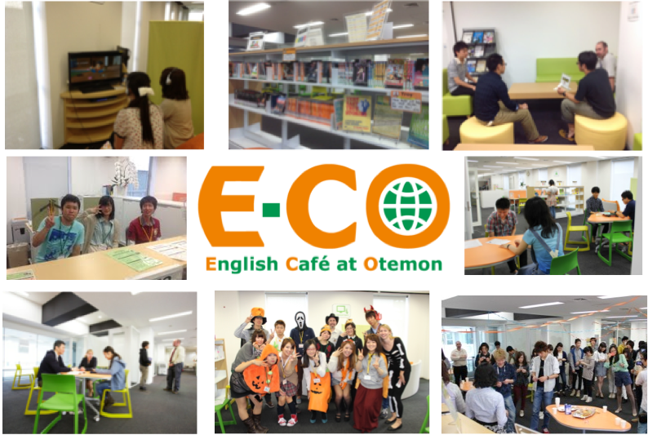
An example: English Café at Otemon
Otemon Gakuin University
Opened April 2013
Around 40 – 70 users per day
Voluntary usage policy
No integration with curriculum

Slide 11
Focus of Evaluation
For university management:
Usage patterns and statistics
Mission statement aims:
Student perceptions of impact on
  Attitudes to English/International Exchange
  English proficiency
  Learner autonomy

Slide 12
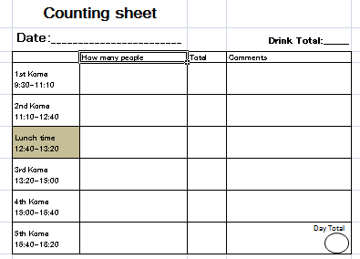
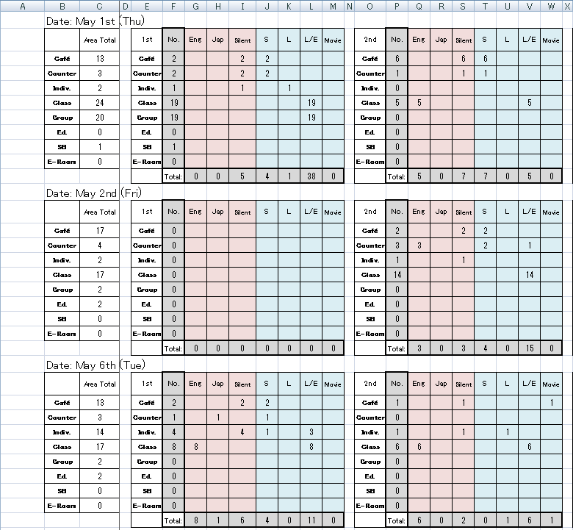
USAGE RECORDS
Language use
Purpose
User head count per koma
Space usage per koma

Slide 13


Description or evaluation?

Slide 14
Measuring E-CO’s impact
Mission Statement | Instrument
Foster positive attitudes towards the learning of English
Develop students’ English language proficiency
Foster language learner autonomy and life-long self-directed learning skills
Generate interest in study abroad and cultural exchange programmes
Nurture intercultural awareness and a sense of global citizenship

Slide 15
Measuring E-CO’s impact
Mission Statement | Instrument
Foster positive attitudes towards the learning of English | Surveys, interviews
Develop students’ English language proficiency | Observations, self-reports (survey), Users’ TOEIC scores/class grades over time.
Foster language learner autonomy and life-long self-directed learning skills | Advising session discourse analysis (over time).
Generate interest in study abroad and cultural exchange programmes | Survey, interviews. Study abroad applications of E-CO users, cultural exchange event attendance
Nurture intercultural awareness and a sense of global citizenship | Survey, interviews (self-reports)

Slide 16


Beware!
Correlation is not causation!
?
Notes:
Students who use SAC already self-selecting.
Likelyto be students who may do well without SAC/be more self-directed.

Slide 17
Conclusion
SAC Managers need to:
Build accountability into recording systems
Have a clear focus for SAC evaluation
Use a variety of instruments
Be creative!
Share results with stakeholders
Act on findings to improve services

Slide 18
Thank You!
Any questions?
thornton.katherine@gmail.com

Slide 19
references
Gardner, D. & Miller, L. (1997) Establishing self-access. Cambridge: Cambridge University Press.
Morrison, B. (2005). Evaluating learning gain in a self-access language learning centre. Language Teaching Research, 9, 3, 267-293

