Slide 1
Establishing a New English Lounge:
Hopes and Challenges
Vick L. Ssali
Greg L. Rohe
(Aichi Gakuin University)

Slide 2
Scale
Institutional
Faculty
Departmental

Slide 3
Institutional:
Administrative Hierarchy
International Exchange Committee
Center of International Programs

Slide 4
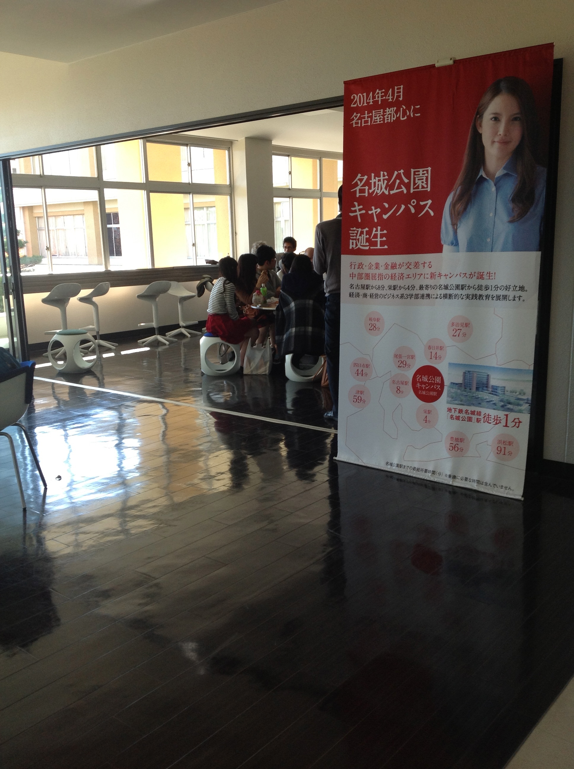
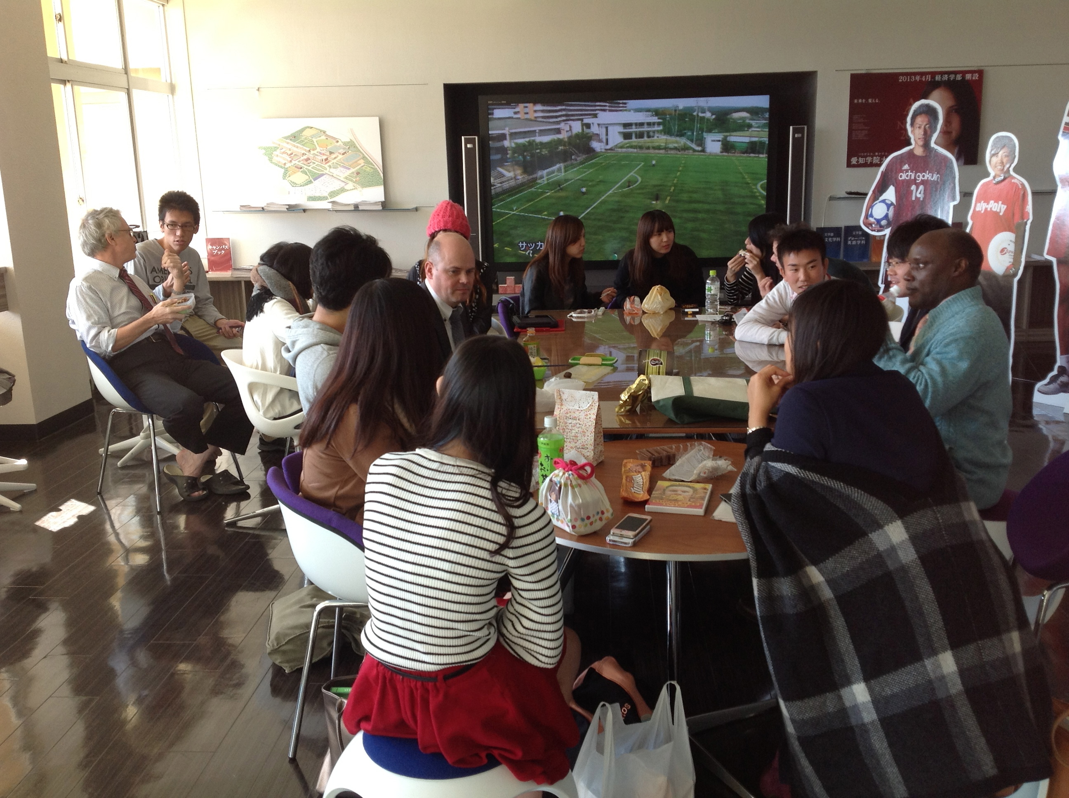
Space
Accessibility
Visibility
Size
A-cube (“AGU English Lunch Club”)

Slide 5
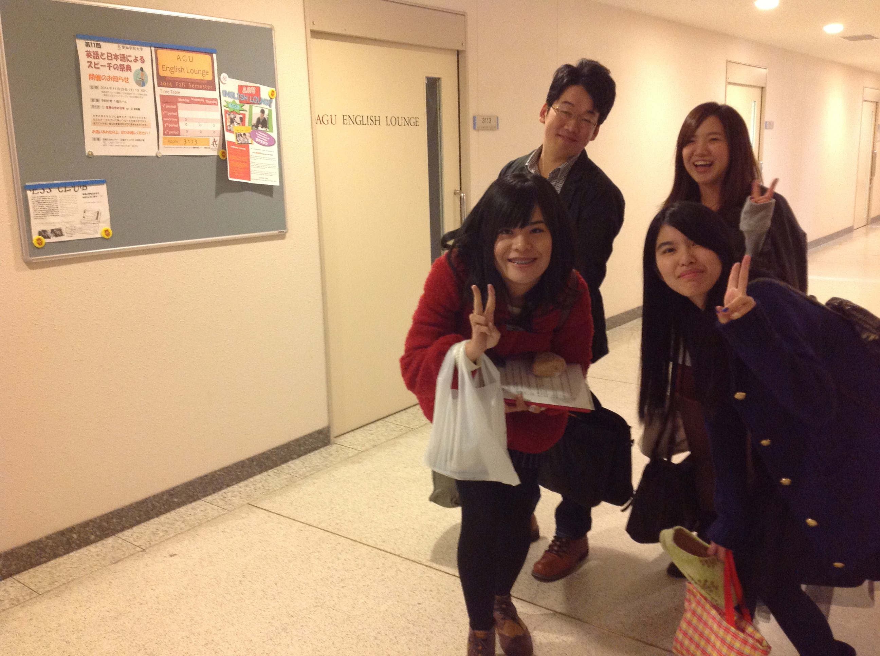
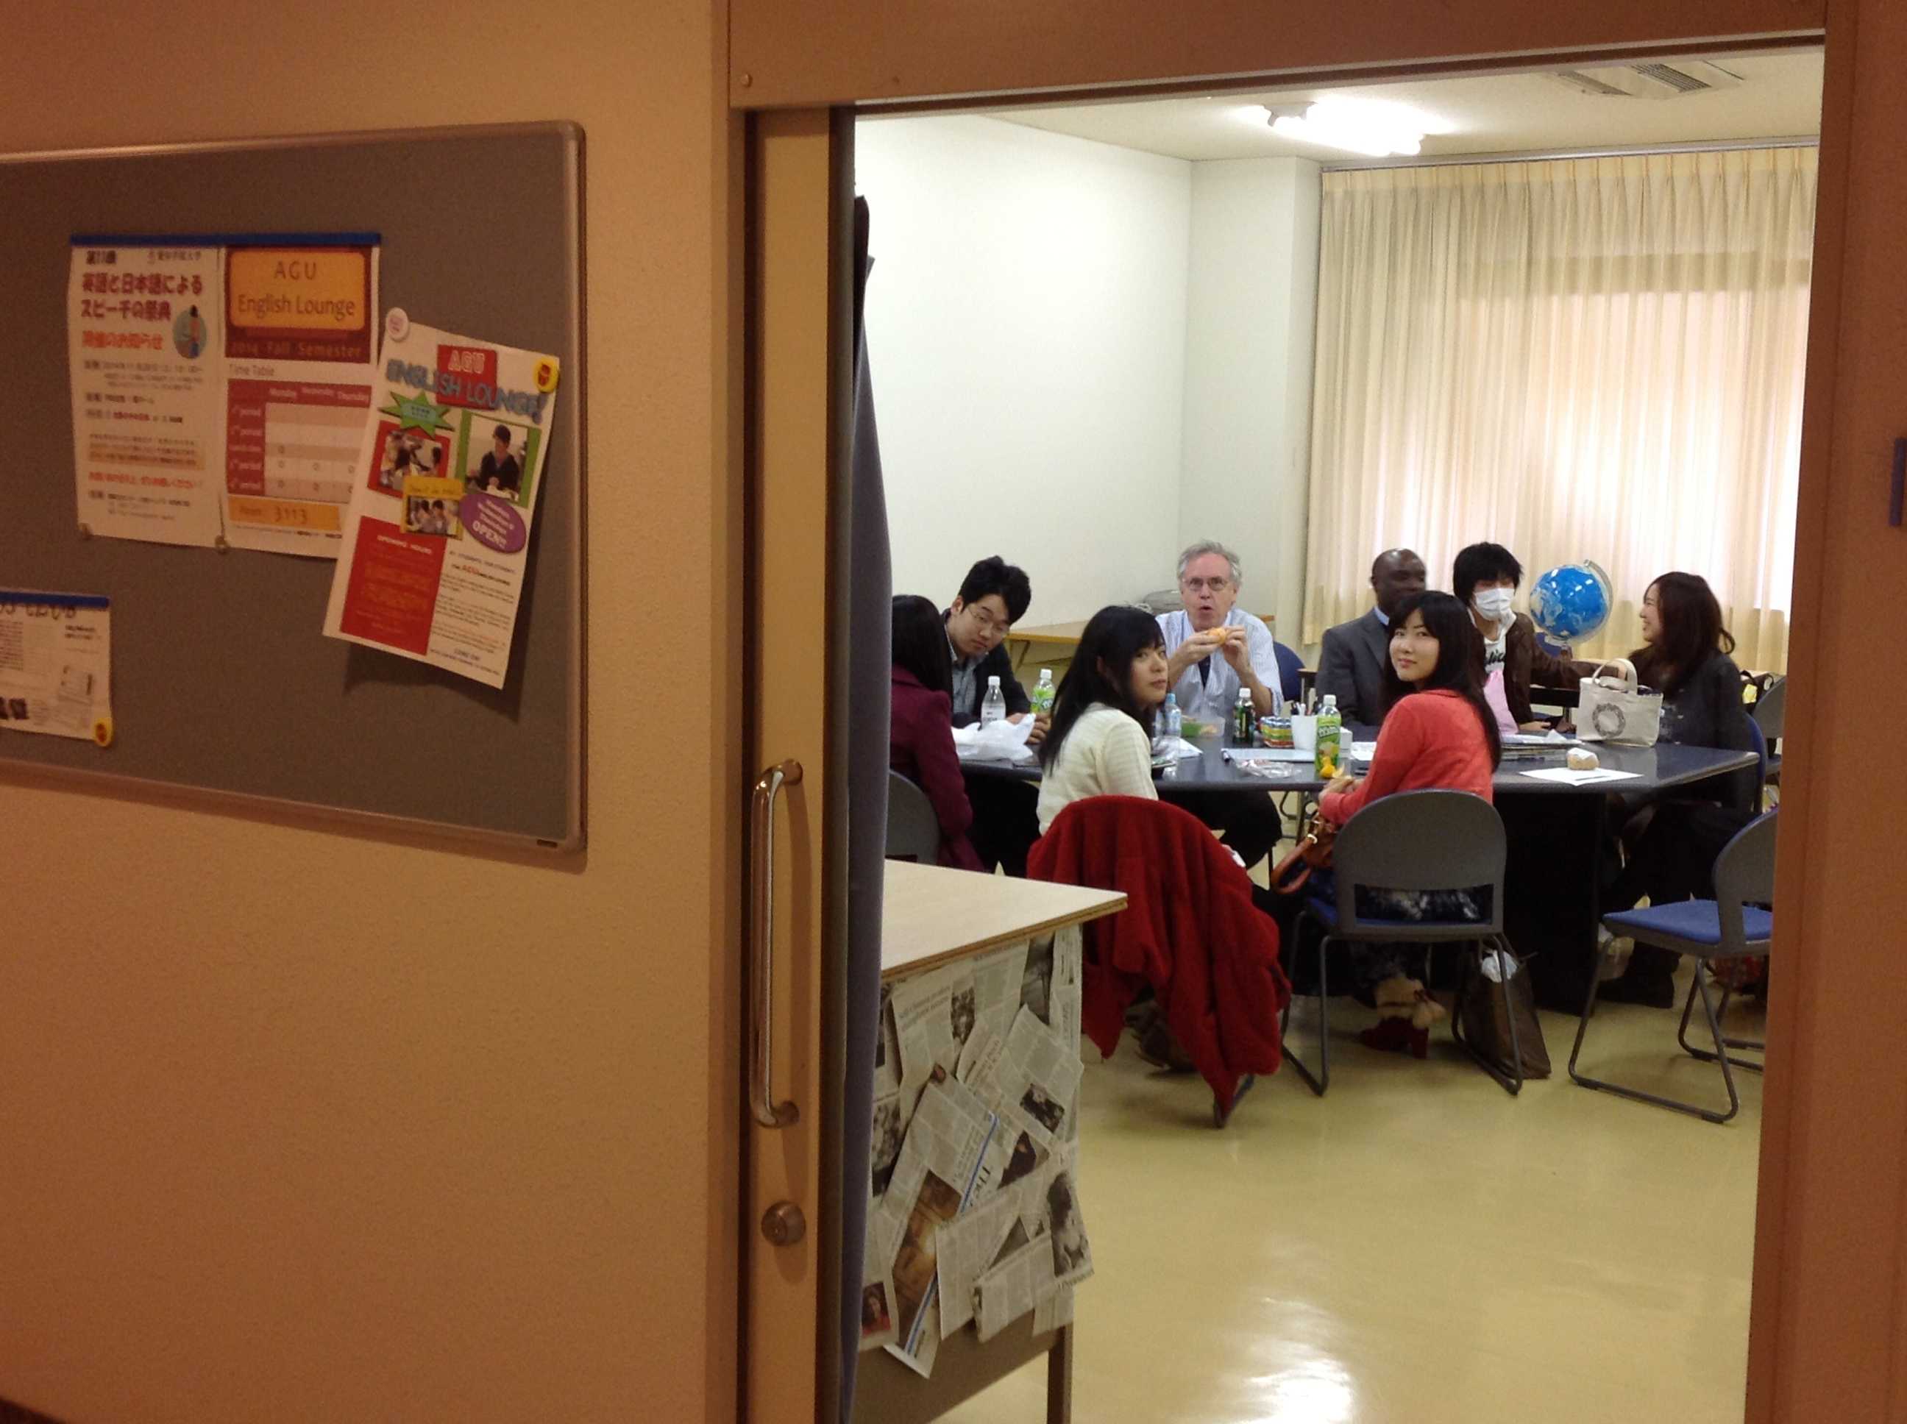
AGU English Lounge

Slide 6
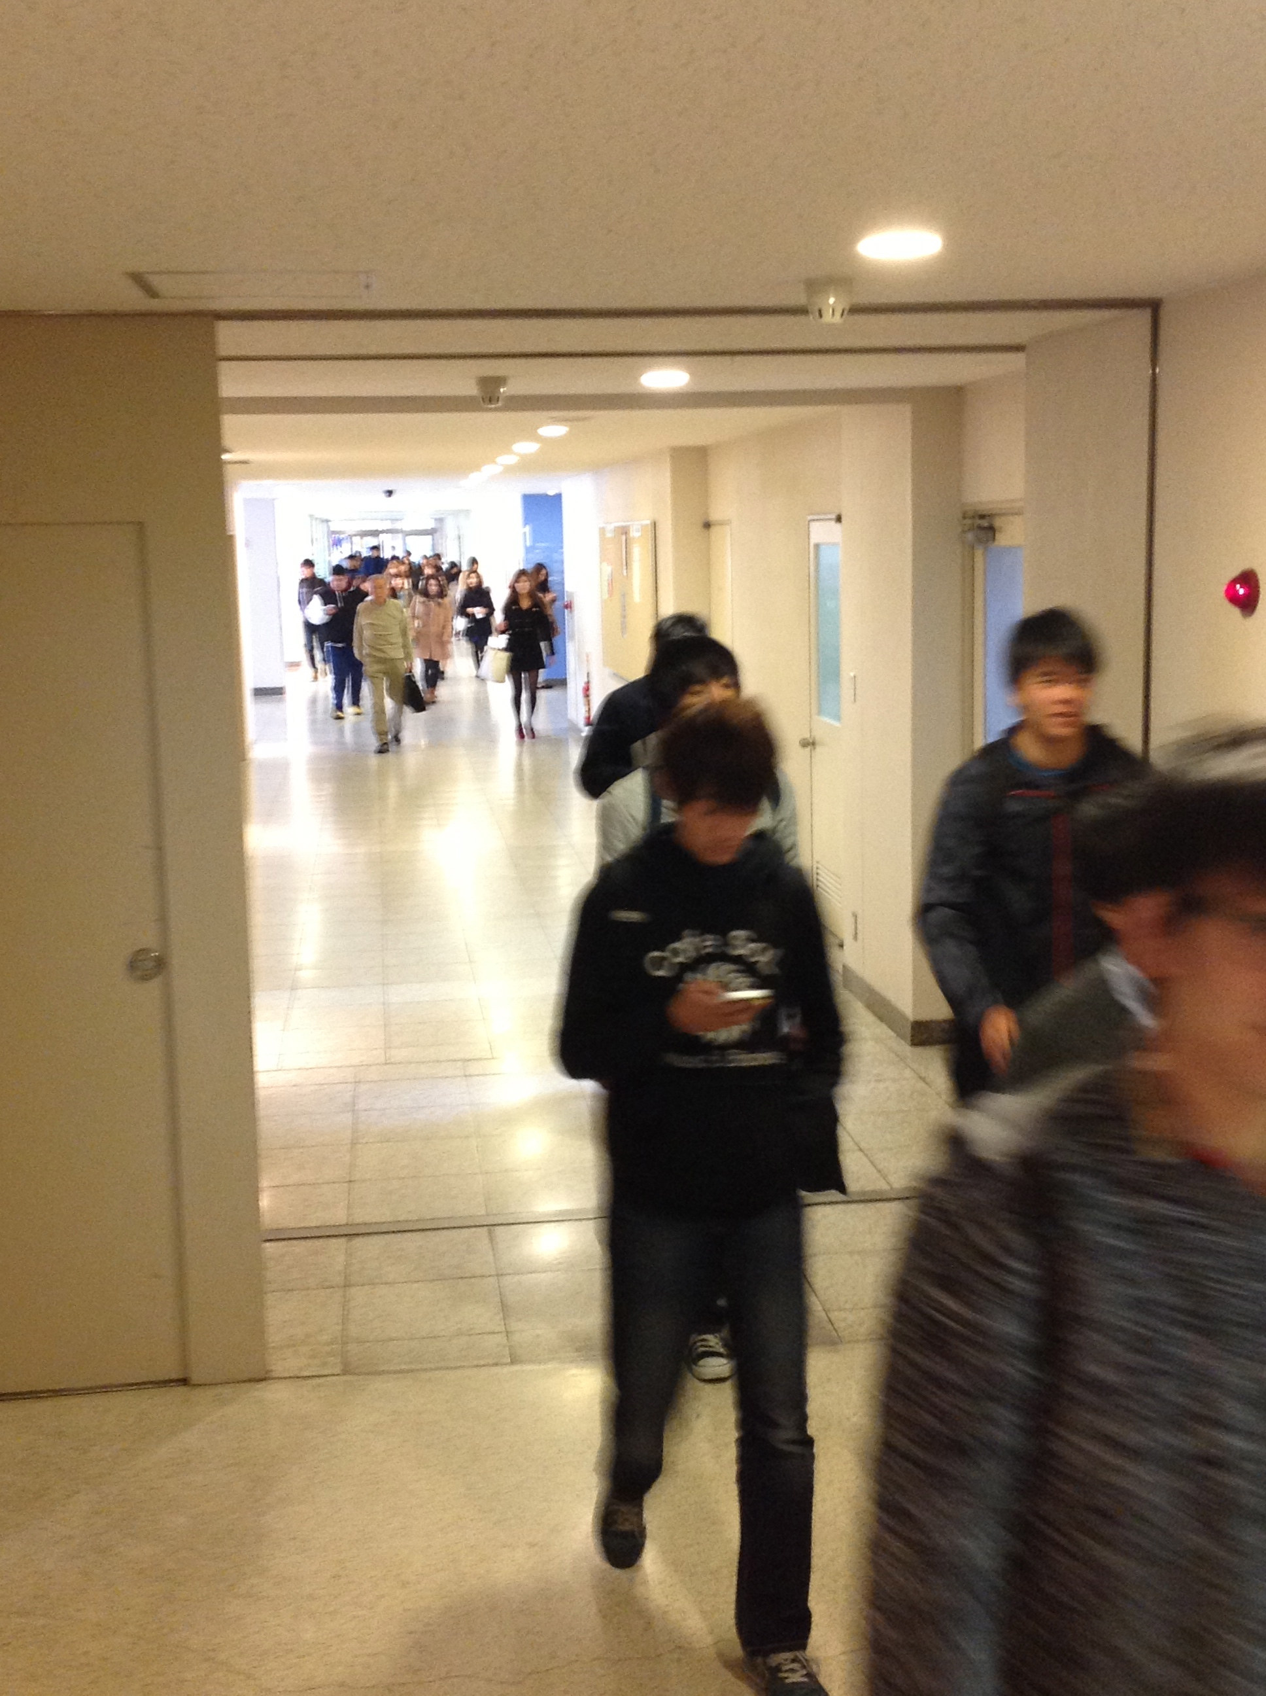
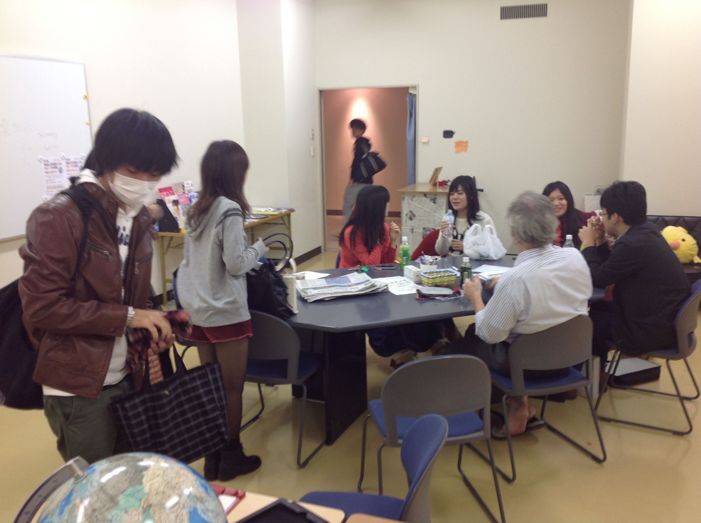
AGU English Lounge

Slide 7
Naming
English Club
English Chat Room
English Saloon
English Lounge

Slide 8
Budgeting
Space
Equipment
Advertising
Staff

Slide 9
Staff
Learning Assistants (LAs)
  “by students / for students”
English Ability
Availability
Opening Hours
Personality

Slide 10
AGU ENGLISH LOUNGE
Challenges

Slide 11
Opening times
FALL 2013 – Spring 2014
Monday lunch time & periods 3.4
Tuesdays periods 1. 2
Thursdays periods 3.4
Fall 2014 –
Monday lunch time & periods 3.4
Wednesdays periods 3.4
Thursdays periods 3.4

Slide 12
Staff
Criteria ?
The staff we have (good speakers)
The staff we want (motivated innovators)

Slide 13
WAY FORWARD
Advertise, specify duties
Train staff
Specify teacher-on-duty

